Slide 1
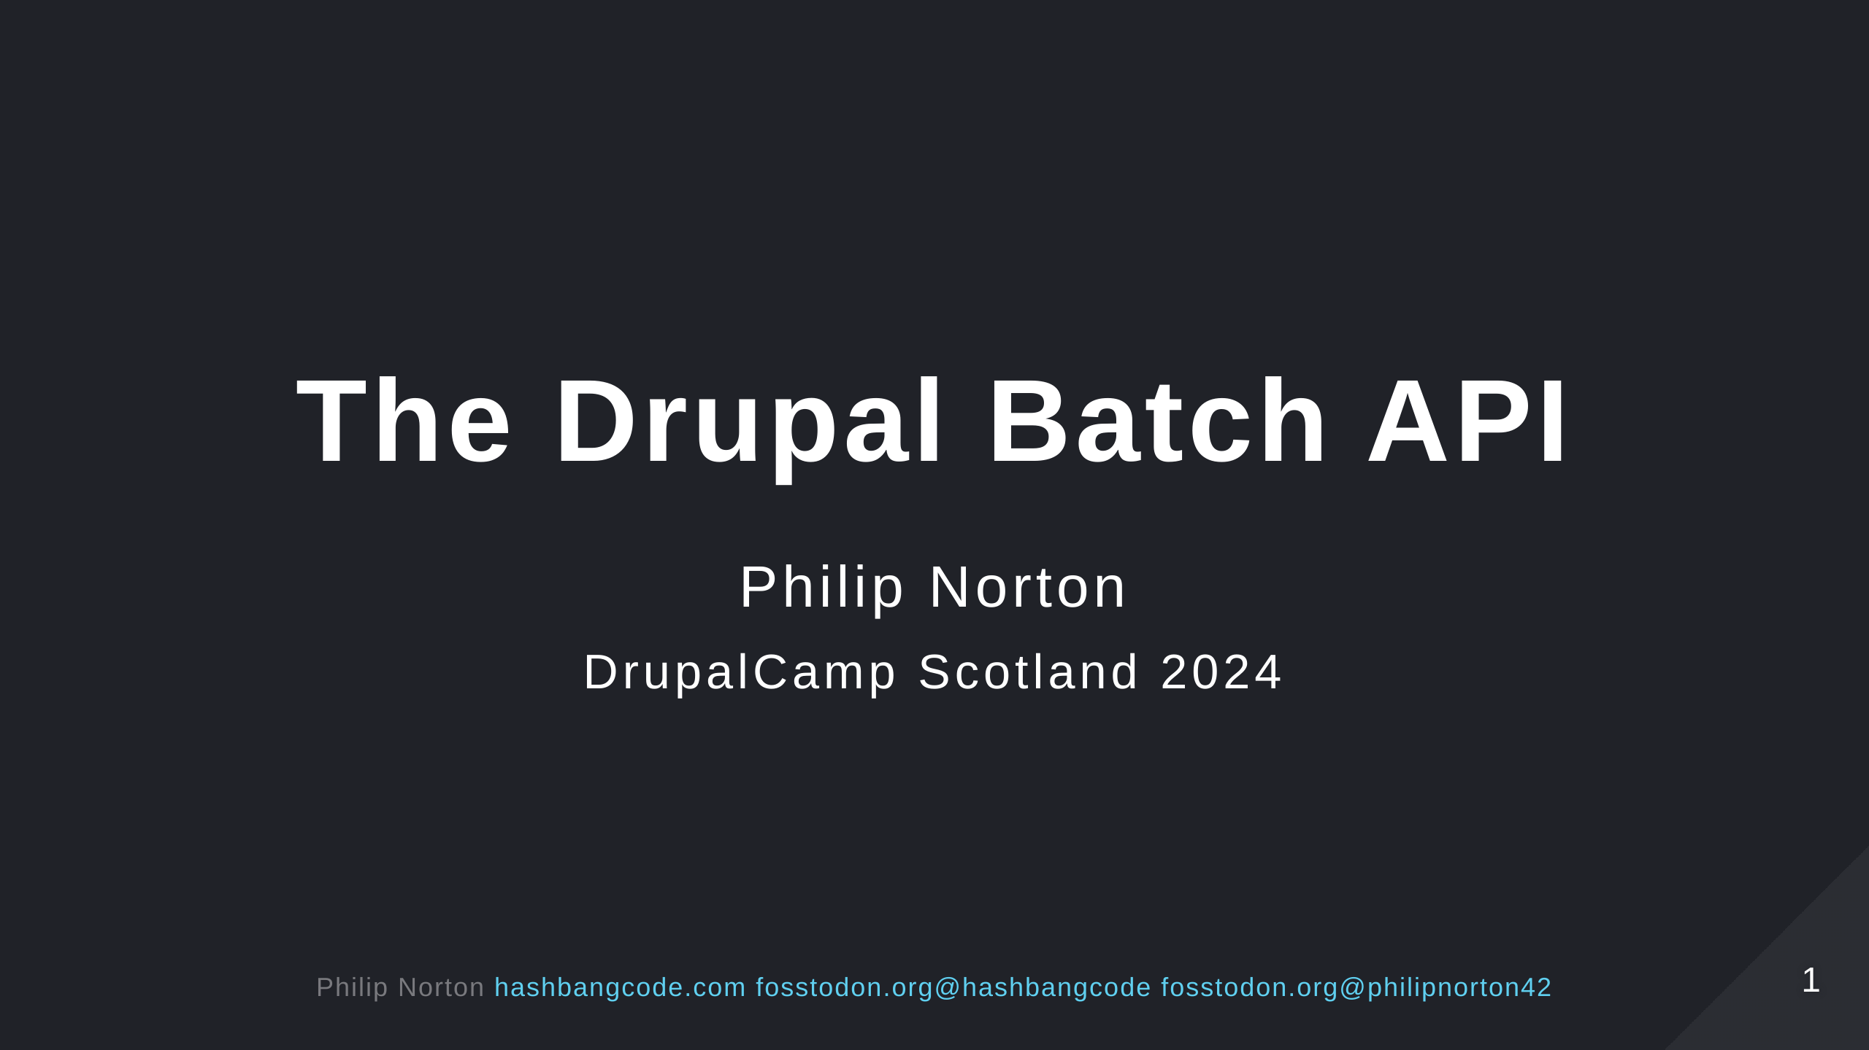

Slide 2
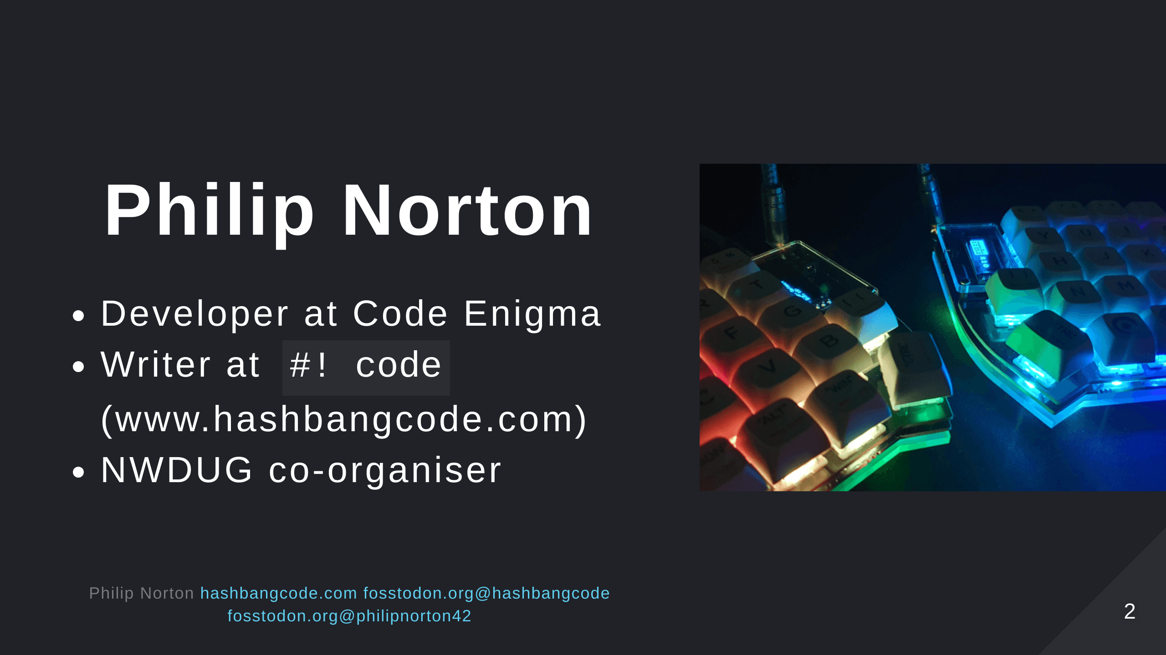
Notes:
- Doing Drupal for about 15 years. - Programming in general for about 20 now. - That is a picture of a Lily58 mechanical keyboard.

Slide 3
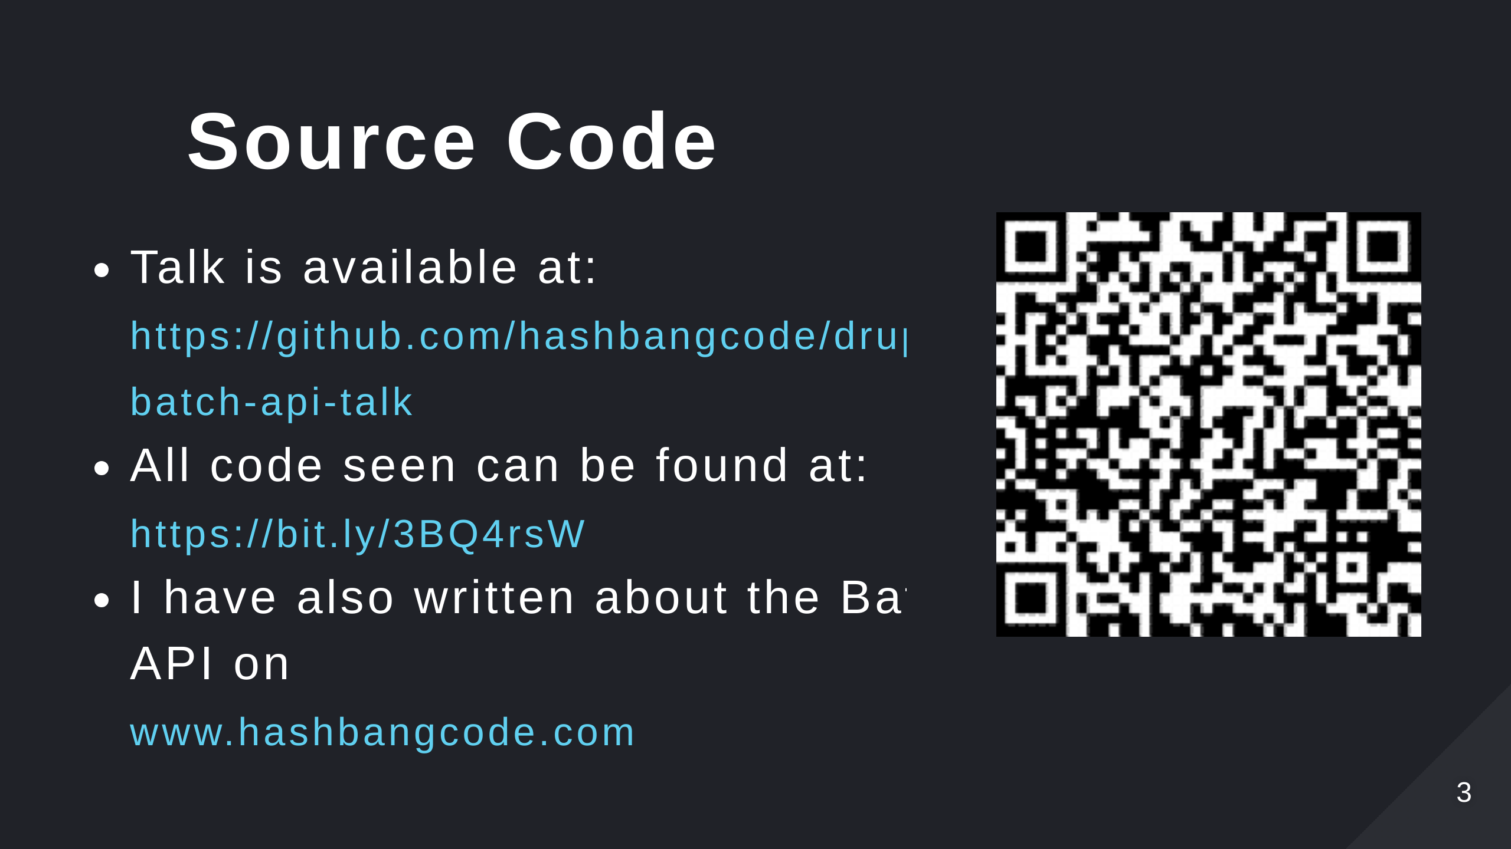
Notes:
- Scan the QR code for the talk repo. Which has links to all of the resources you need.

Slide 4
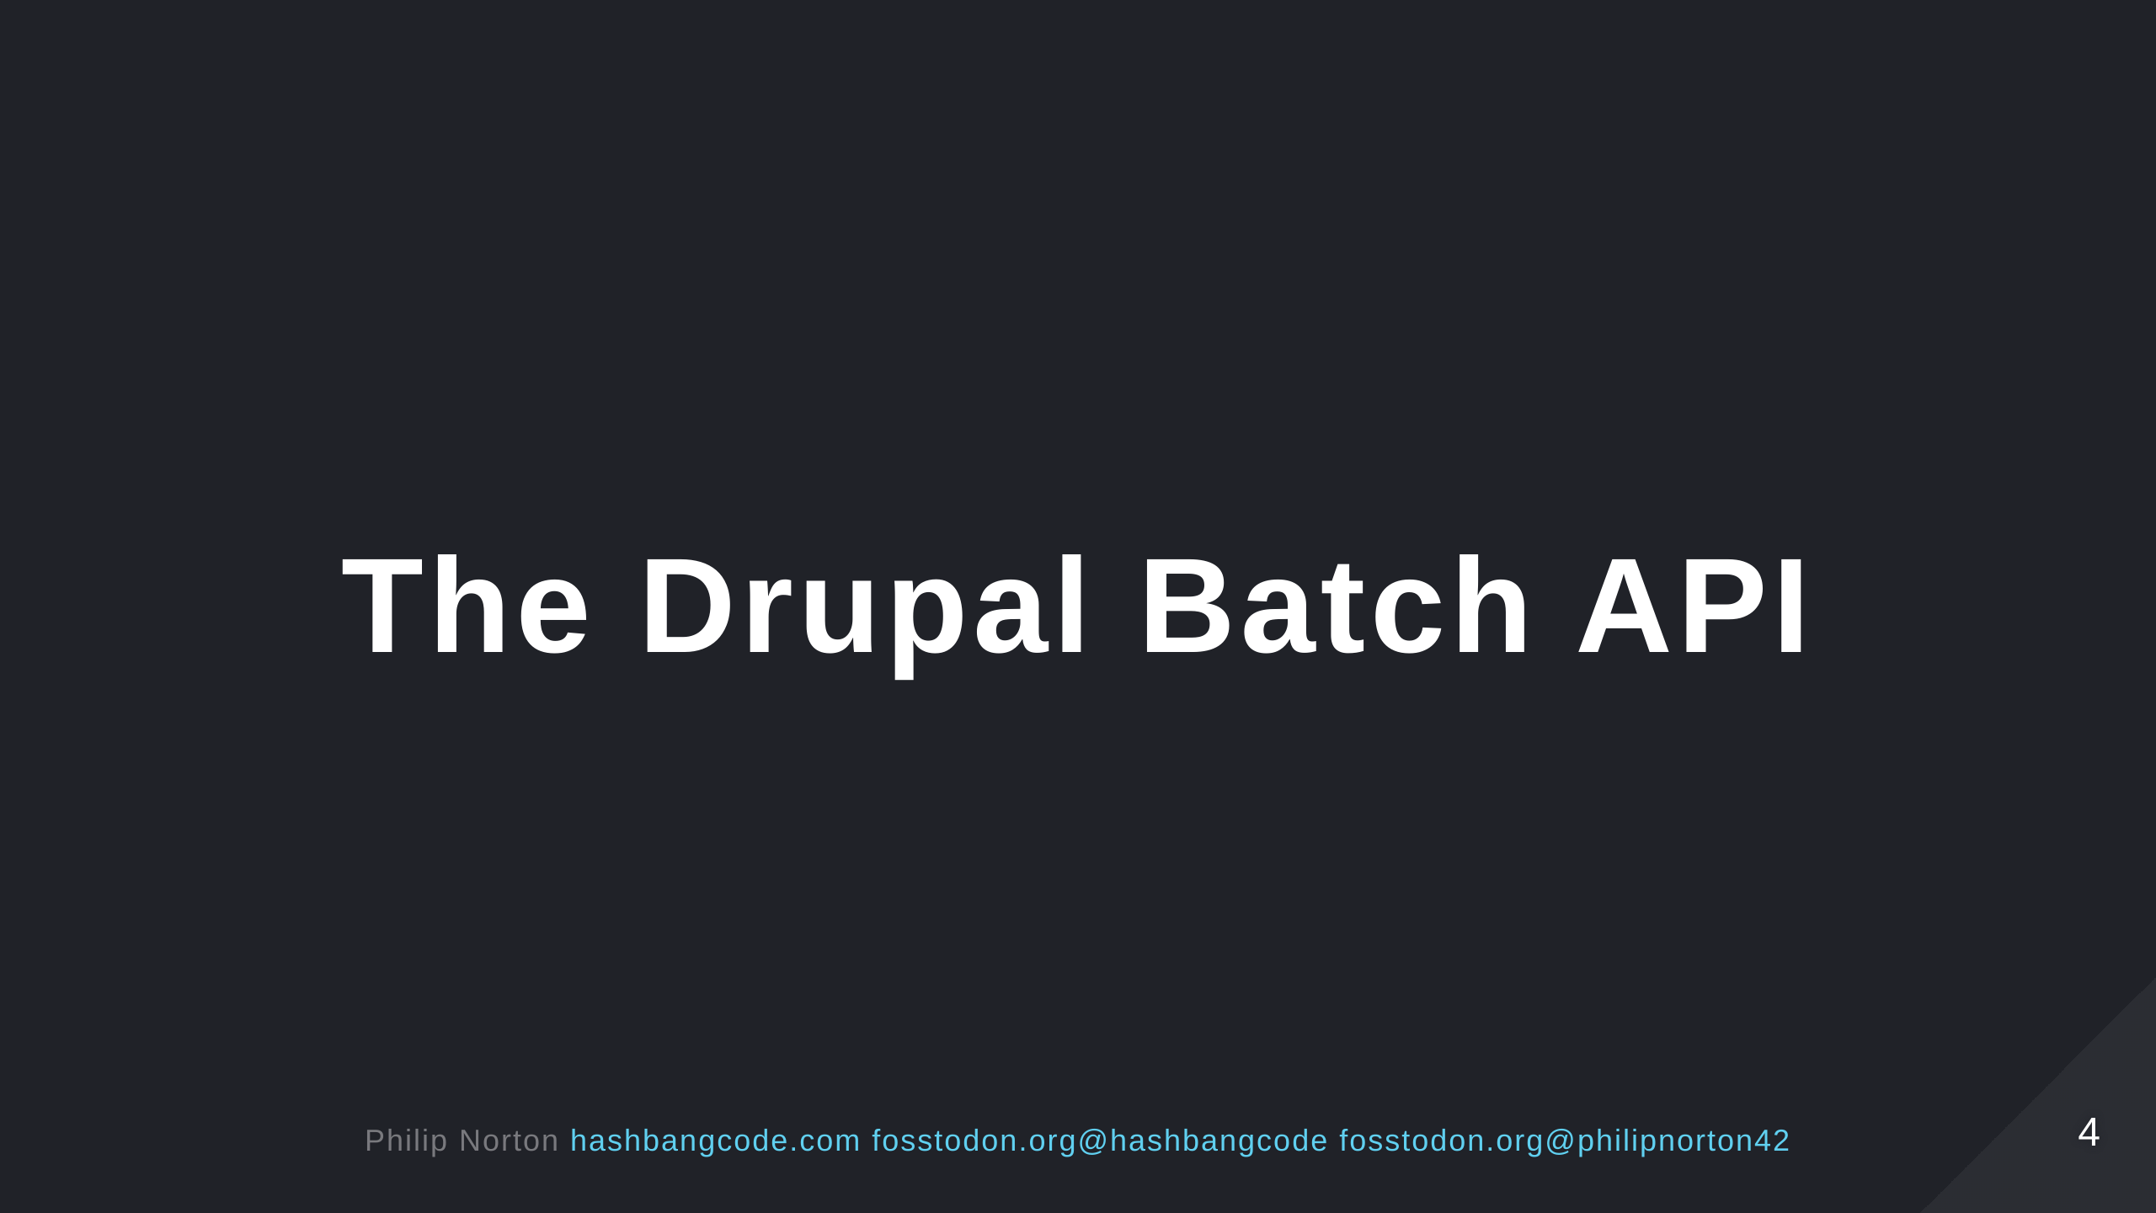
Notes:
The Drupal Batch API is a system that allows us to split up large tasks into smaller chunks so that we don't overload the web server. This is a really important concept to understand if you are developing your own Drupal modules, especially if you want to allow users to perform actions on lots of items at once. In this session we will look at why we need the Drupal Batch API and how it prevents issues. We'll then do a dive into the code surrounding the Batch API and how to run your own batch operations. There will be a few demos on running the Batch API to perform some simple tasks. Finally, we'll look at how Drupal uses the Batch API internally and some use cases of the Batch API in contributed modules.

Slide 5
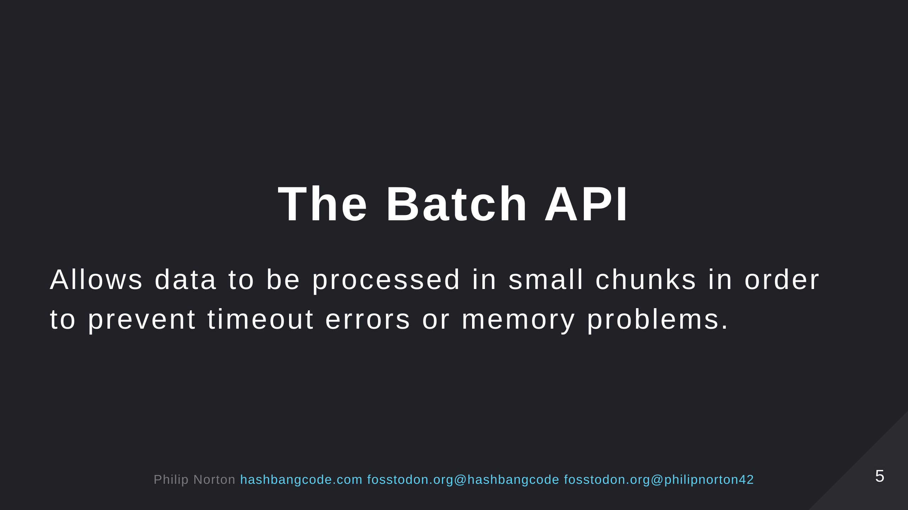

Slide 6
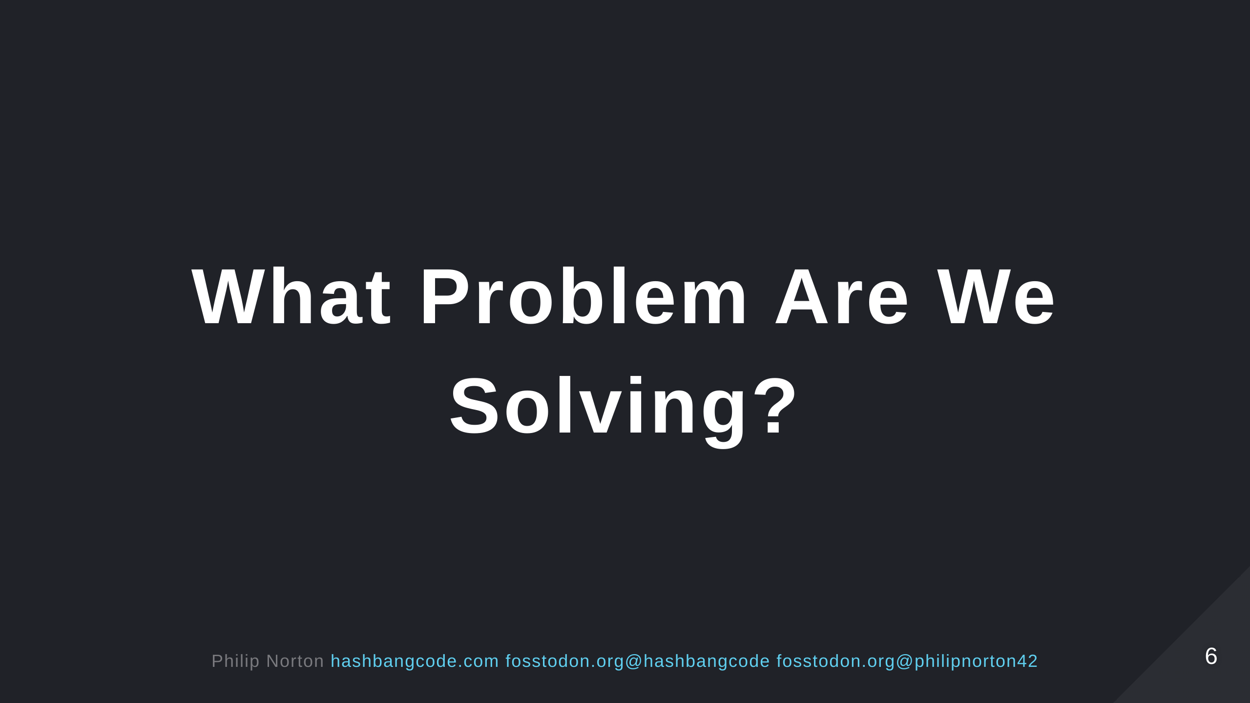

Slide 7
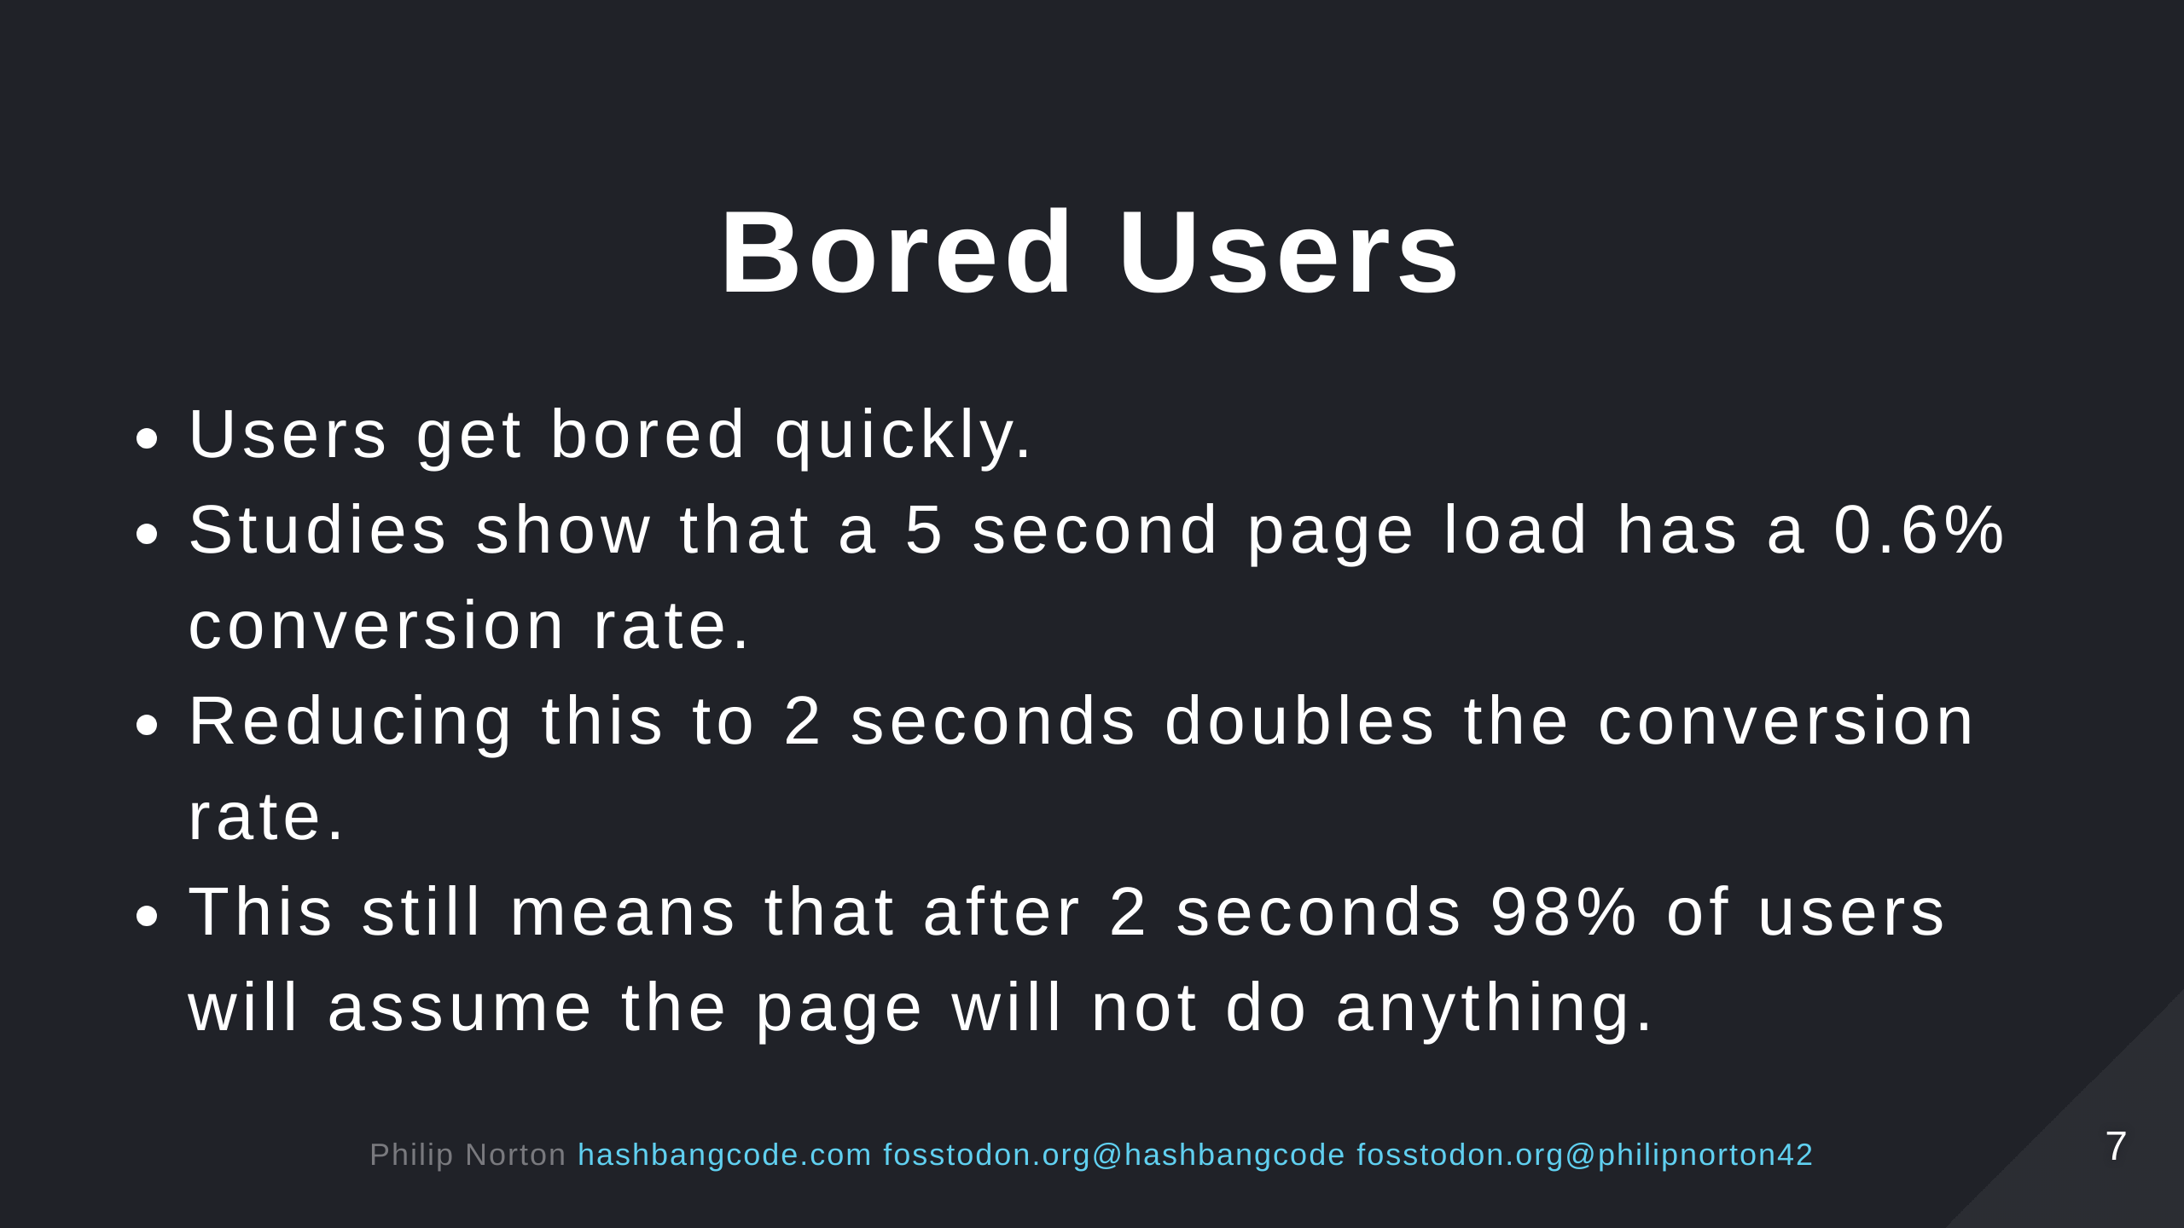
Notes:
Source: https://www.cloudflare.com/learning/performance/more/website-performance-conversion-rates/

Slide 8
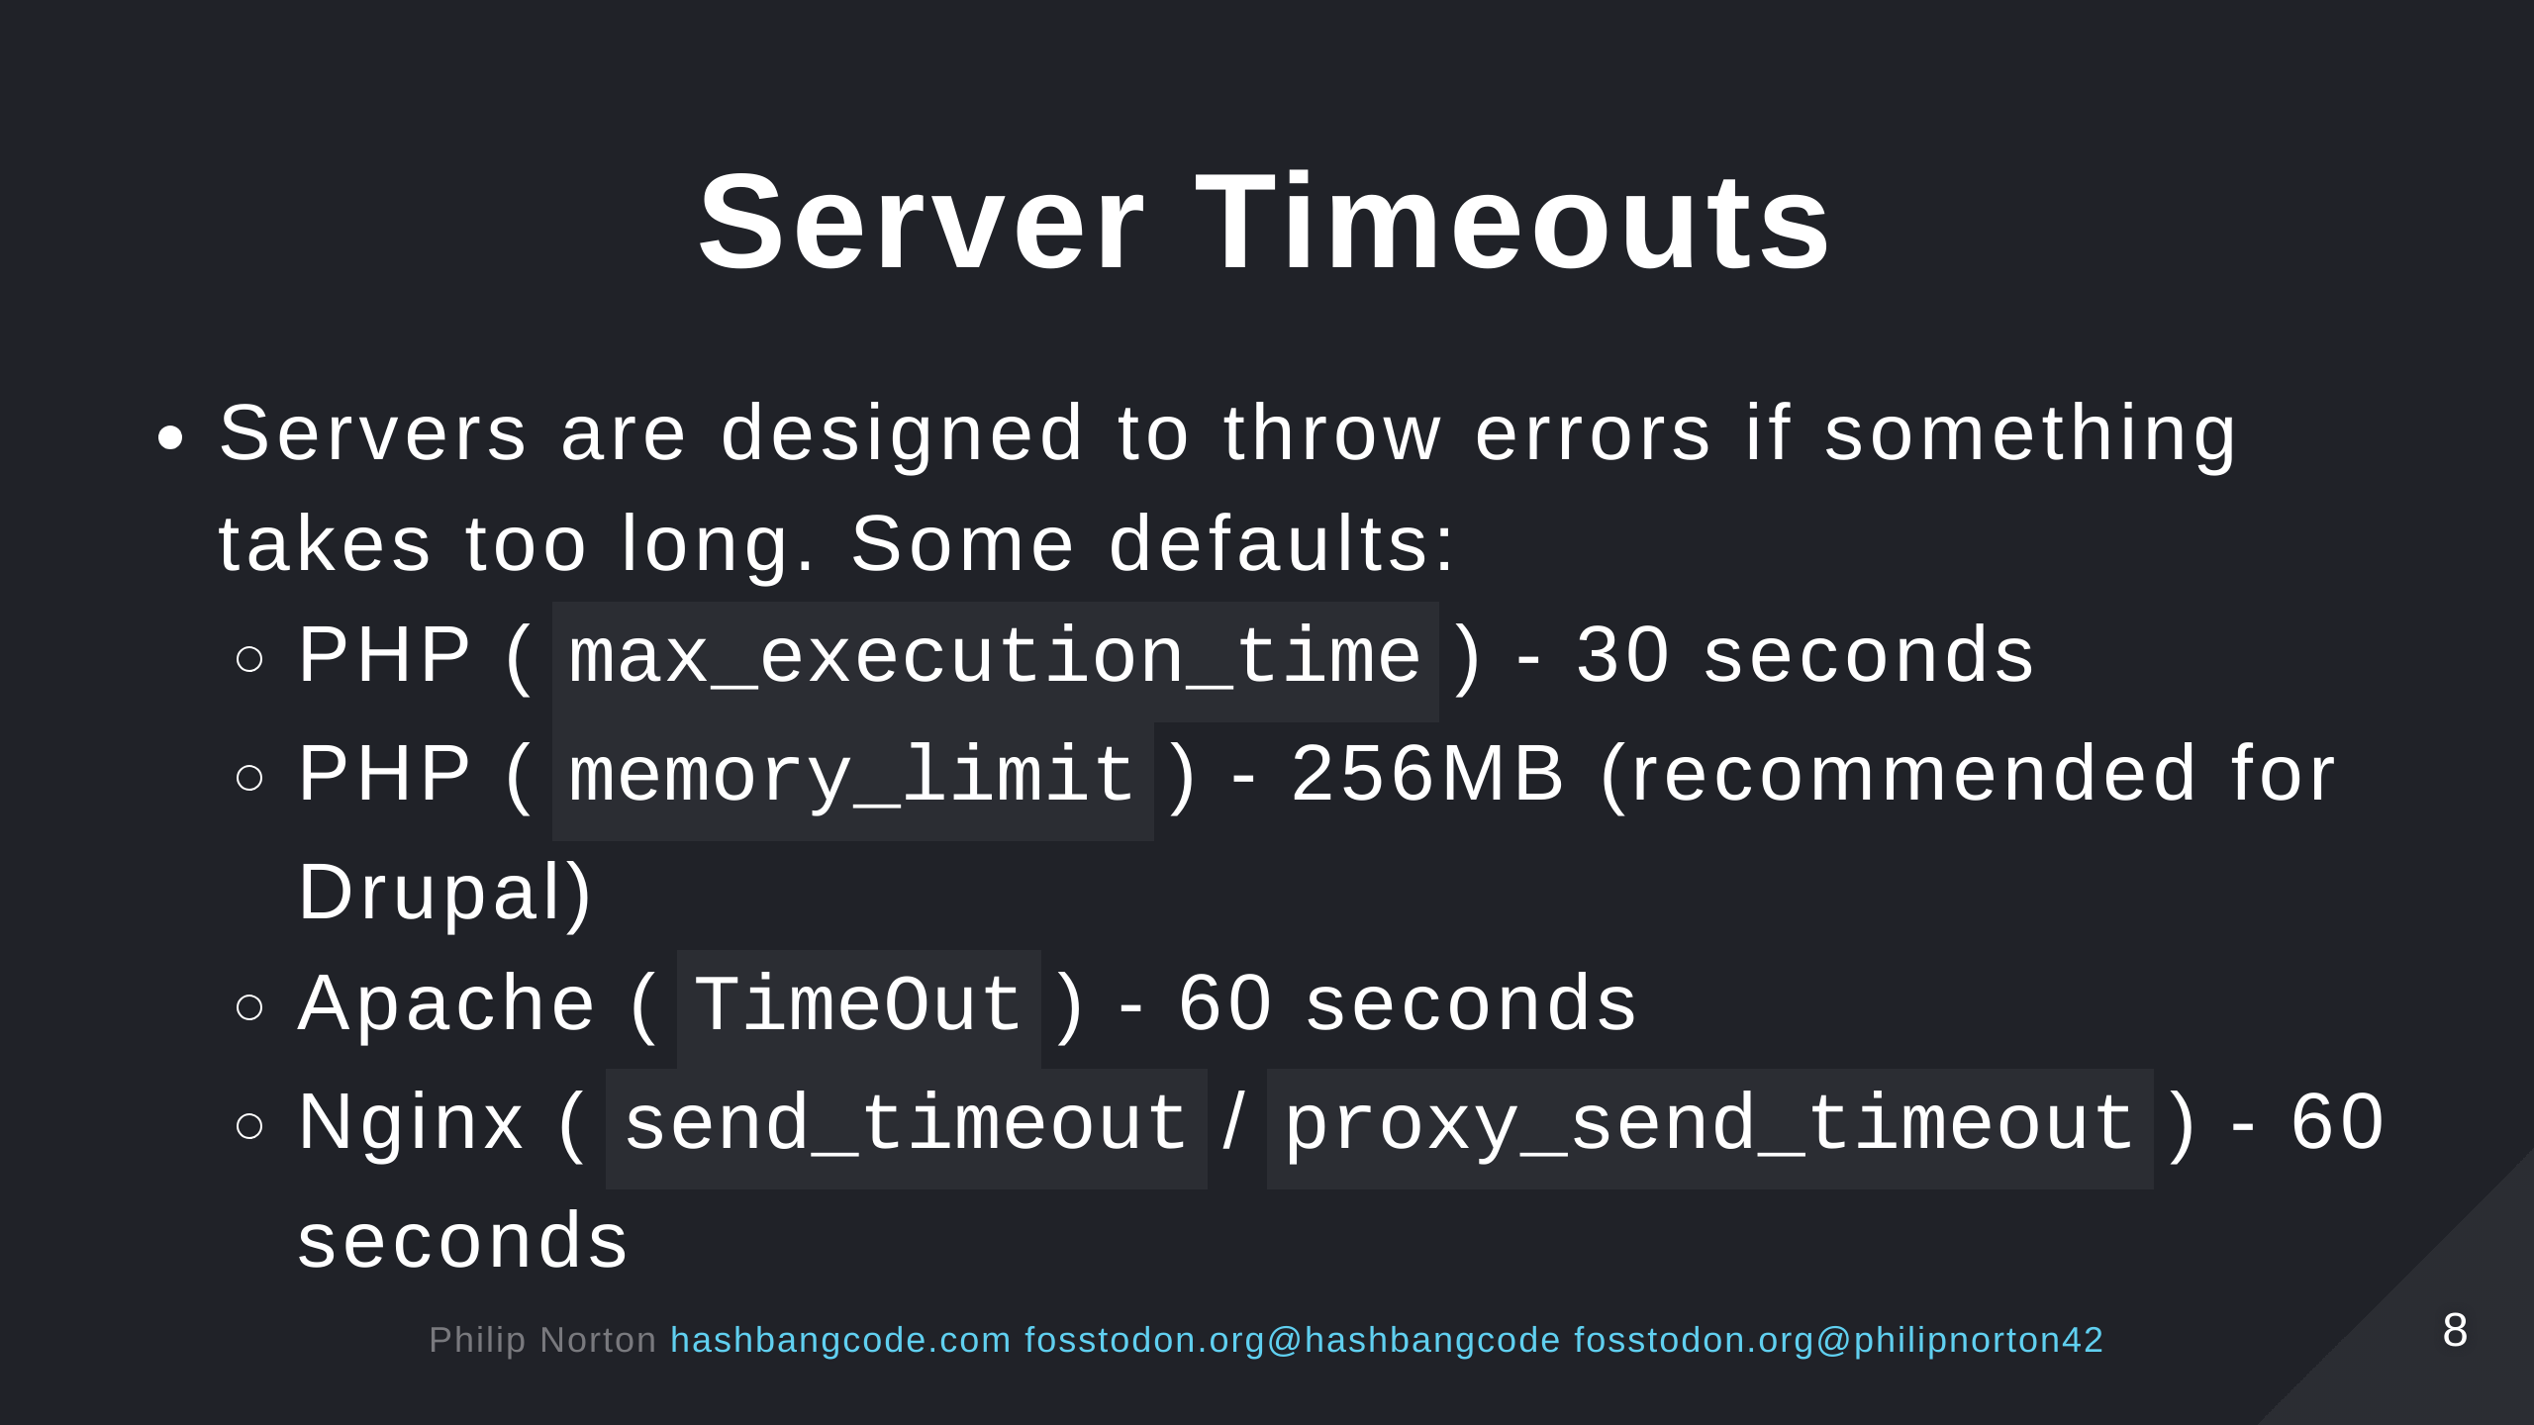
Notes:
- CDNs also sit on top of this. With even stricter timeout limits. - You can override all these options. - But, setting them high would cause problems on your web server. - The more resources you give to these services, the less users you can accommodate at once. - Think about how long a page request should take in you web server. 2-5 seconds MAX!

Slide 9
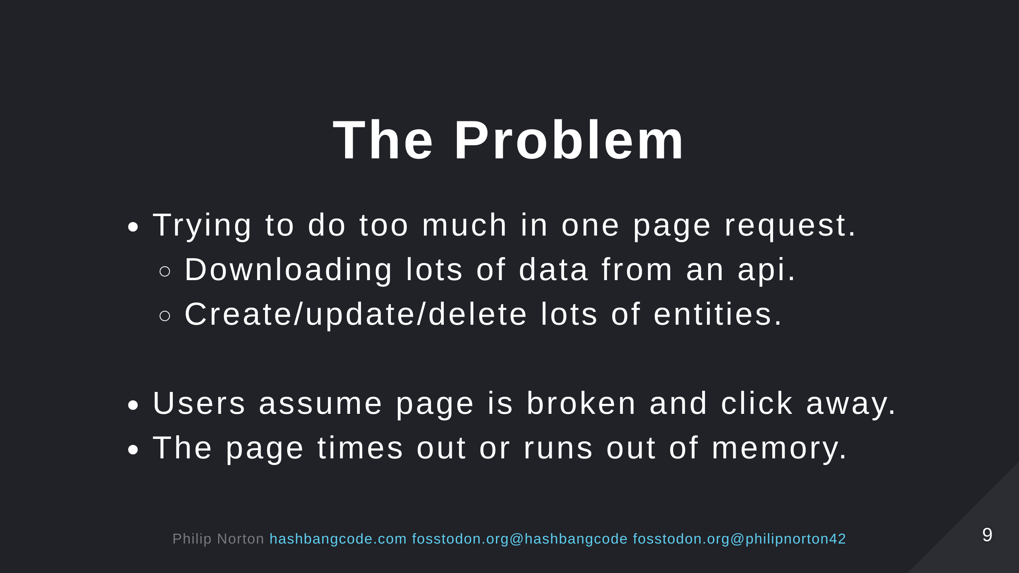

Slide 10
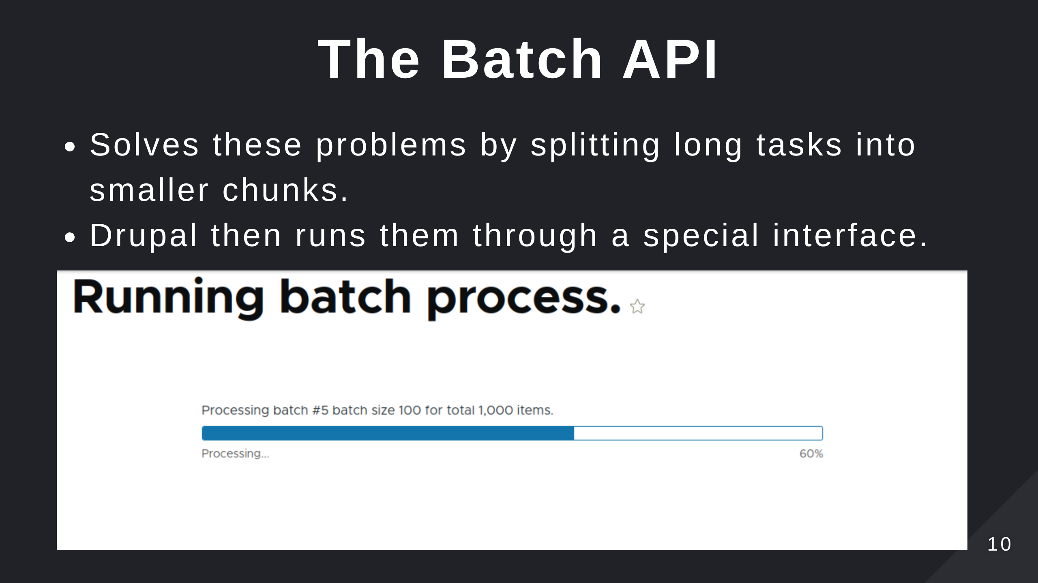

Slide 11
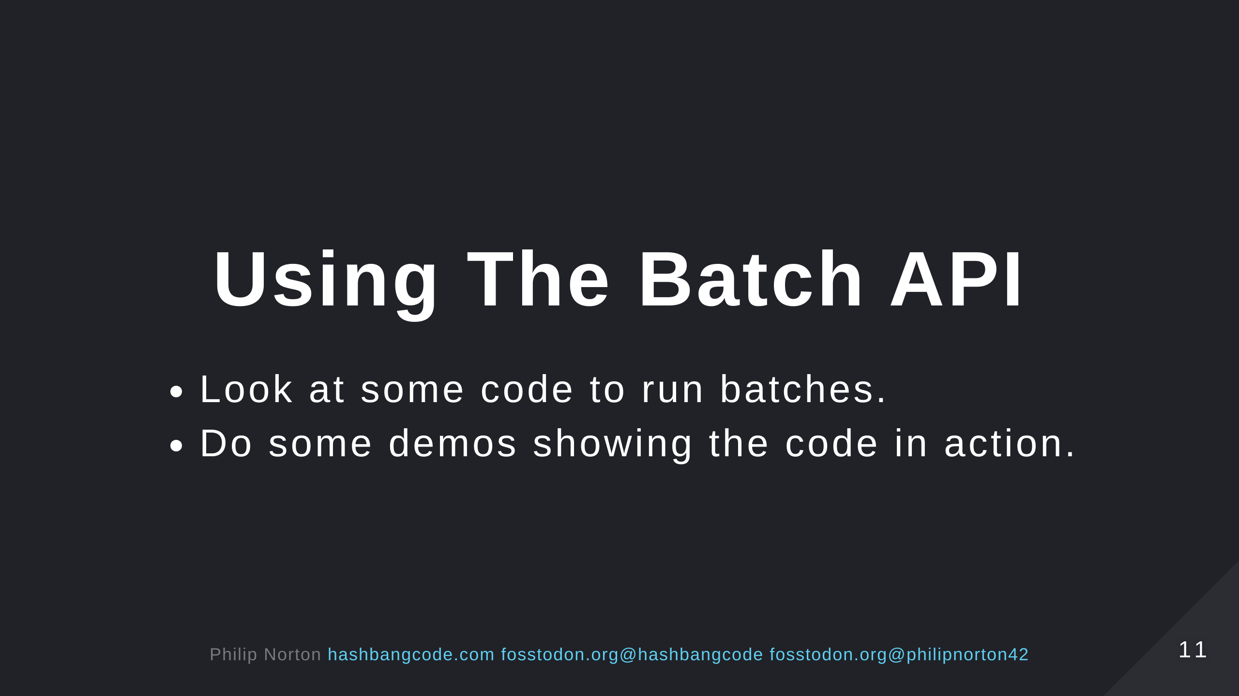

Slide 12
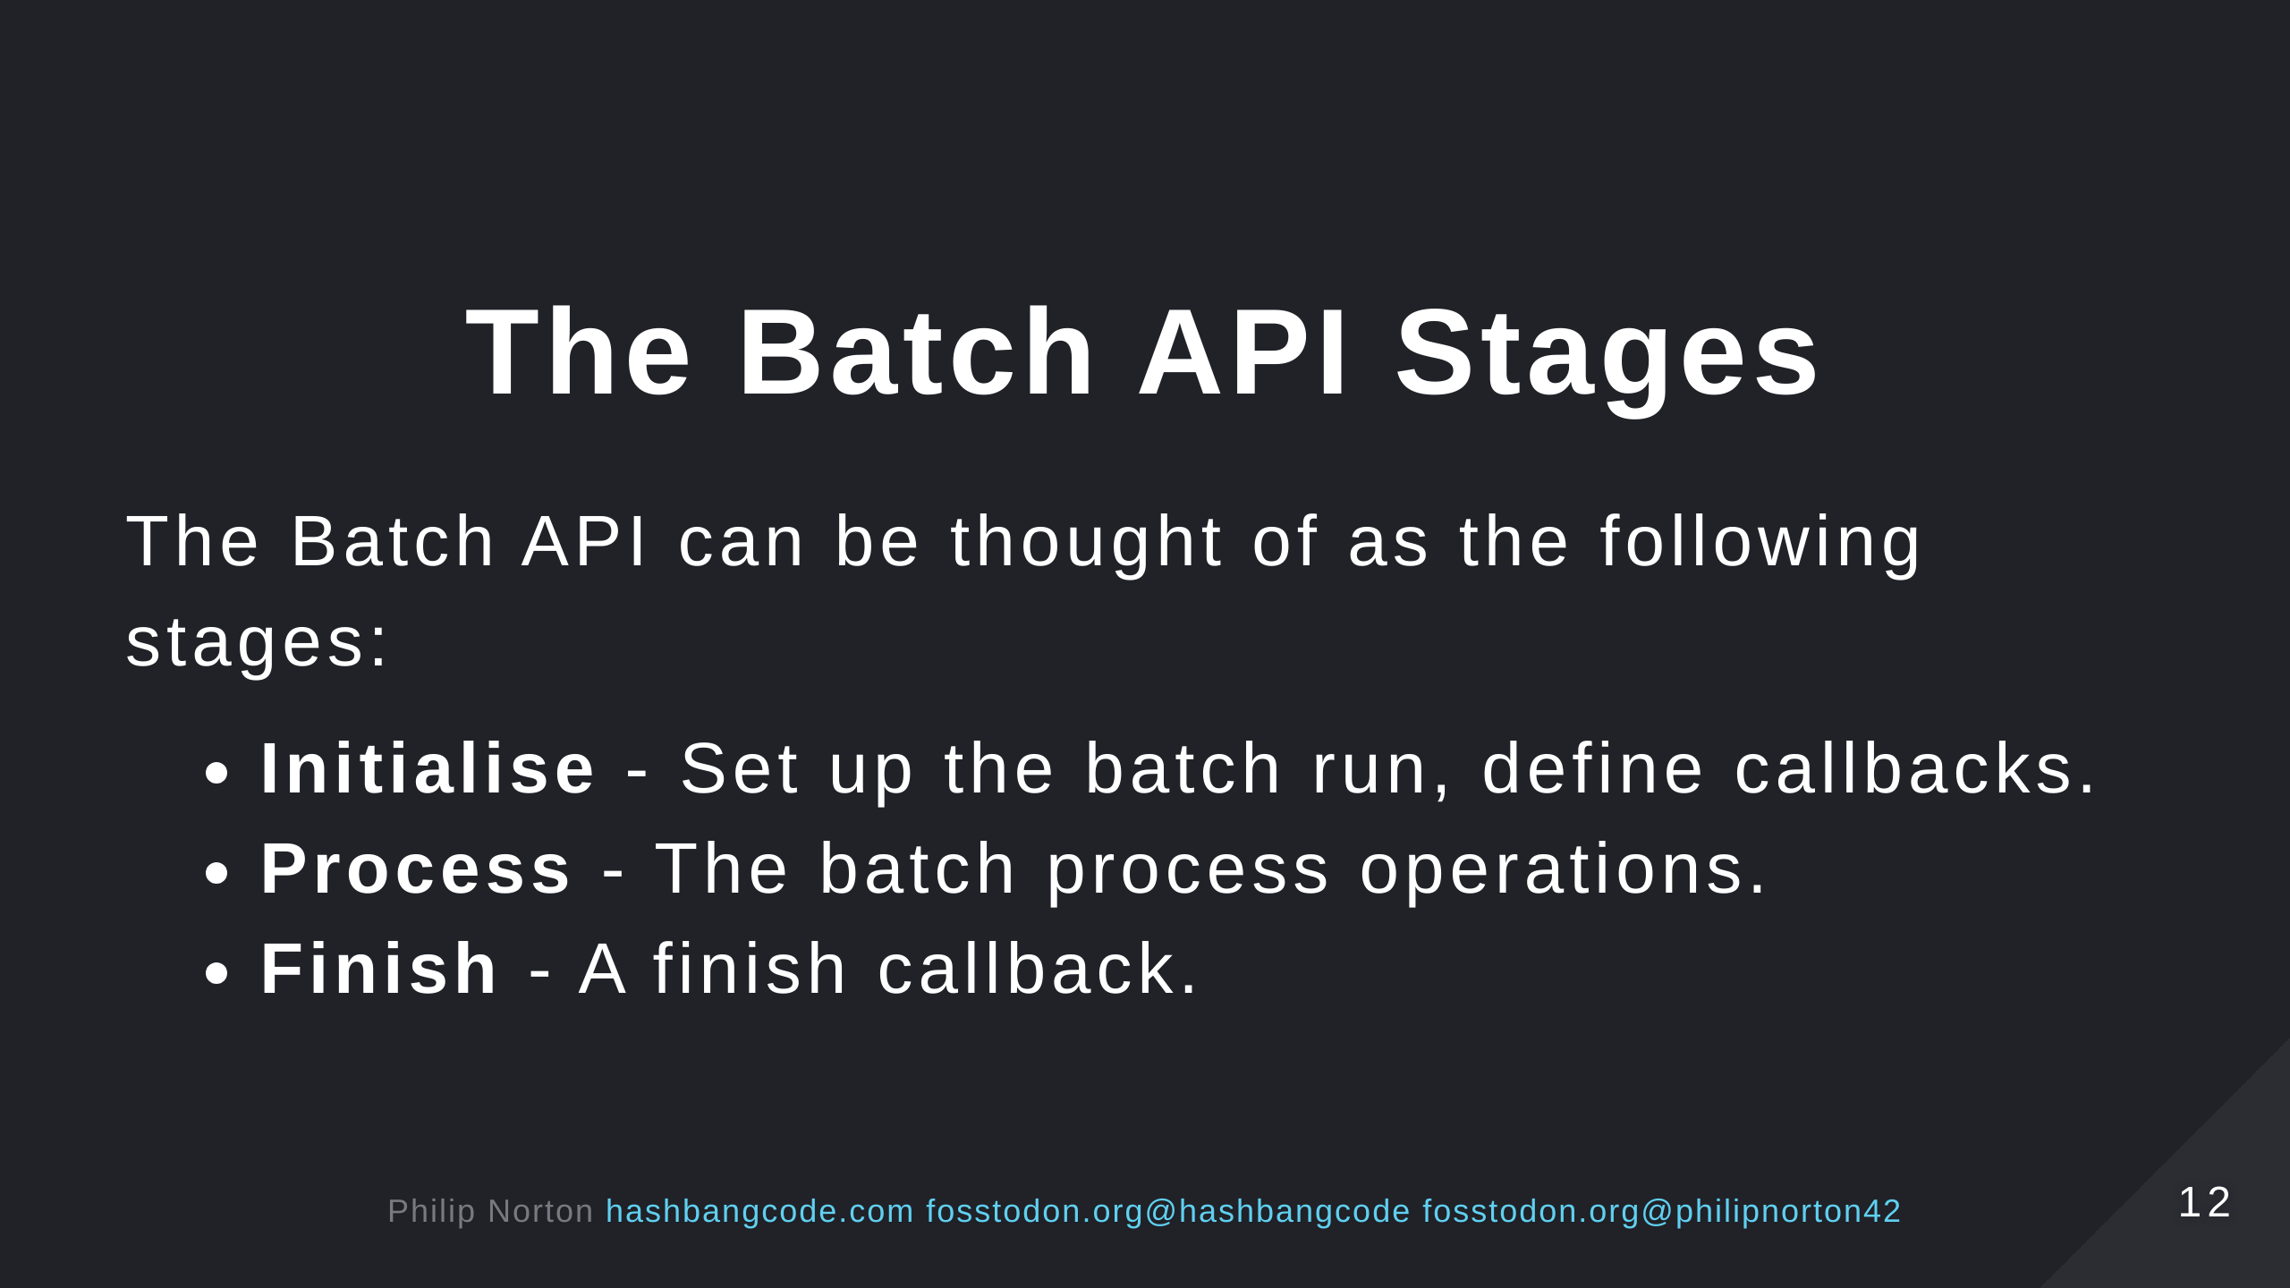

Slide 13
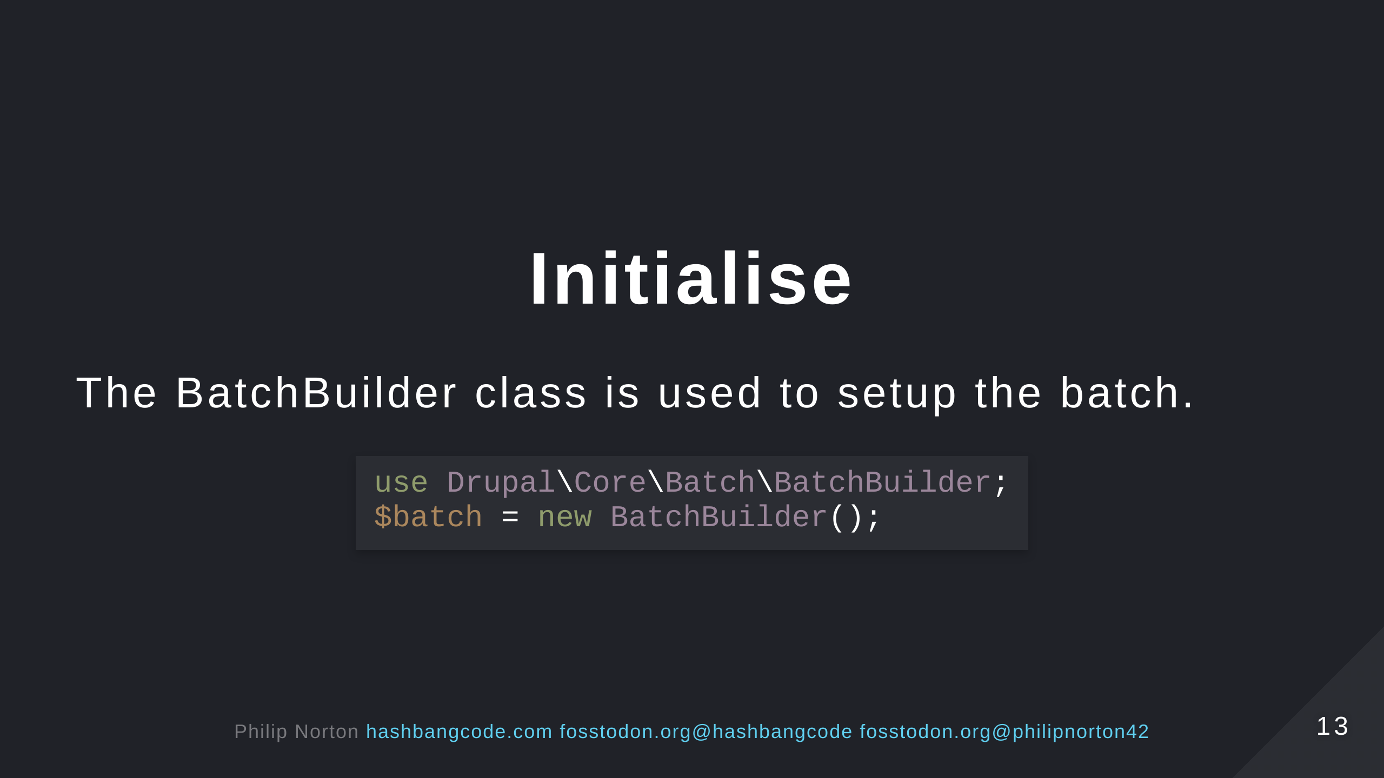

Slide 14
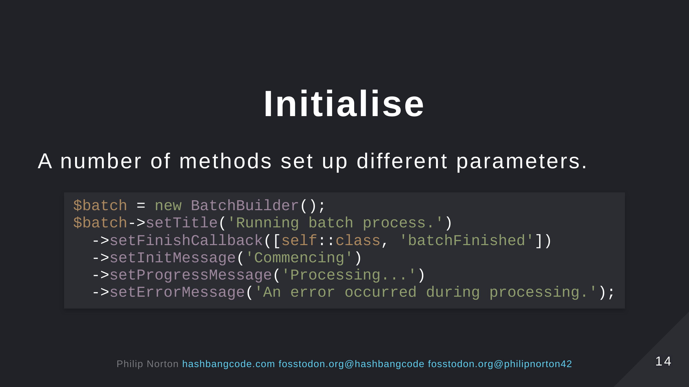

Slide 15
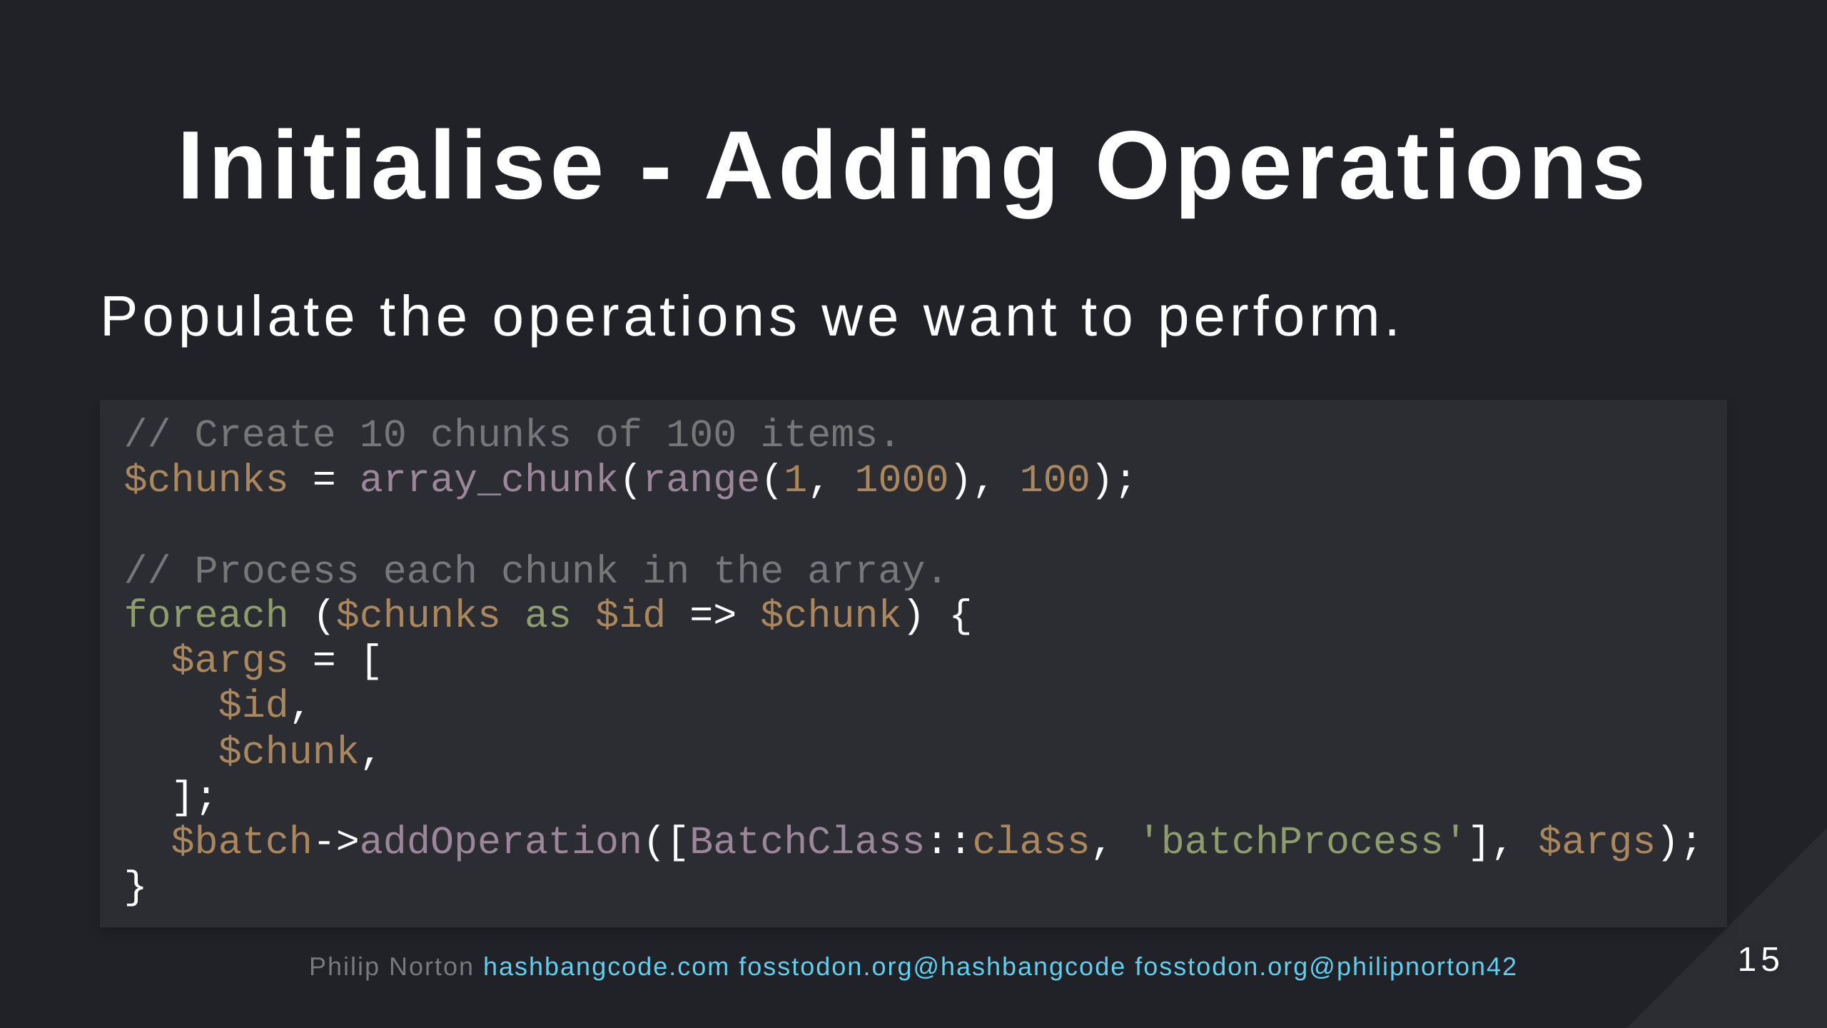
Notes:
- You can add multiple operations to perform different tasks.

Slide 16
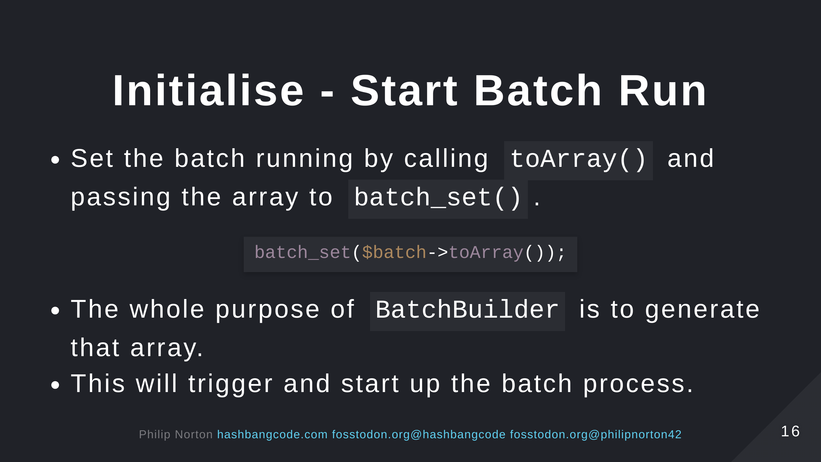
Notes:
- This will redirect to the batch processor interface and call the process operations. - Yes you can also just define the array and send it to batch_set(), but I find BatchBuilder a nicer interface. - This is how Drupal uses the batch system internally.

Slide 17
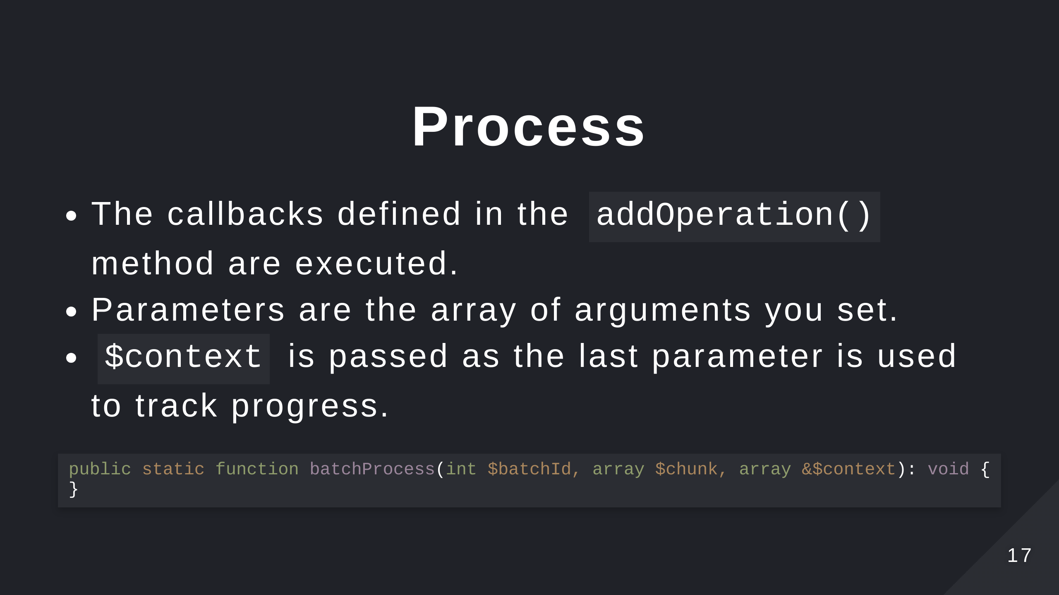

Slide 18
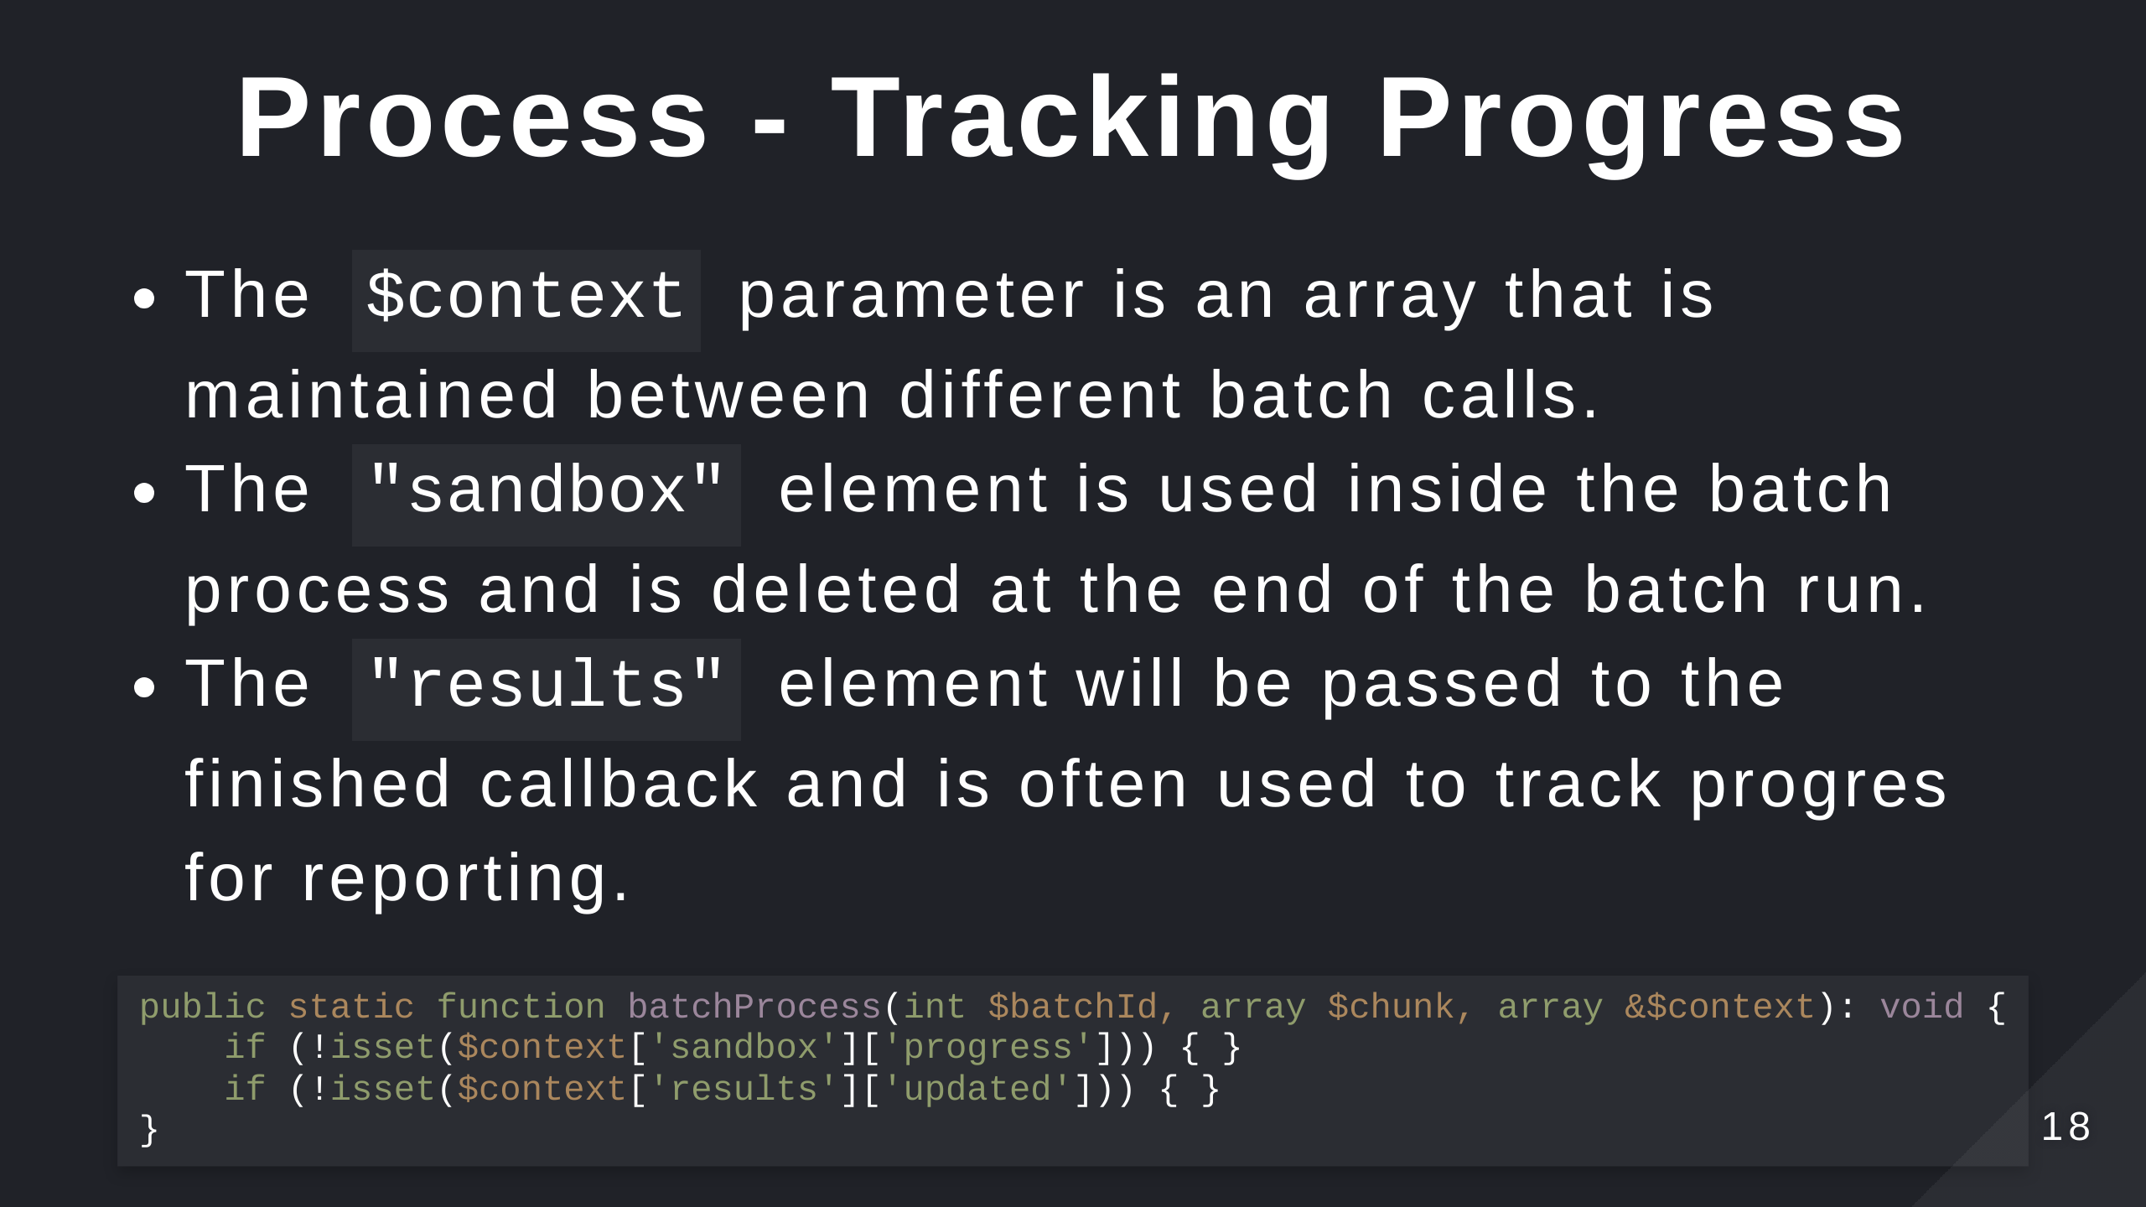

Slide 19
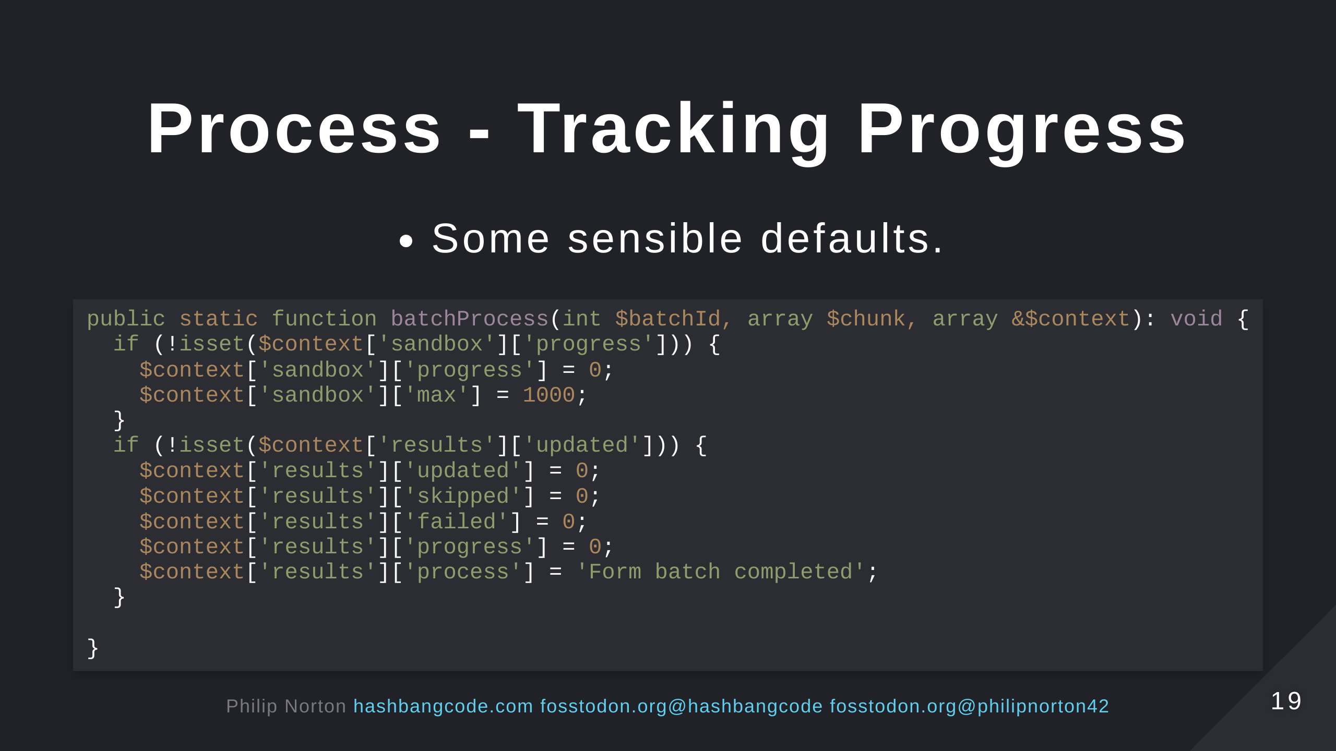
Notes:
- Remember that the sandbox is thrown away once the batch has completed. - That's why we have progress in results and in sandbox.

Slide 20
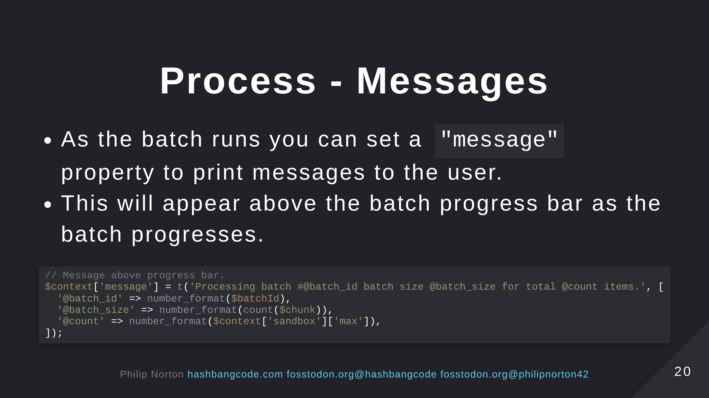

Slide 21
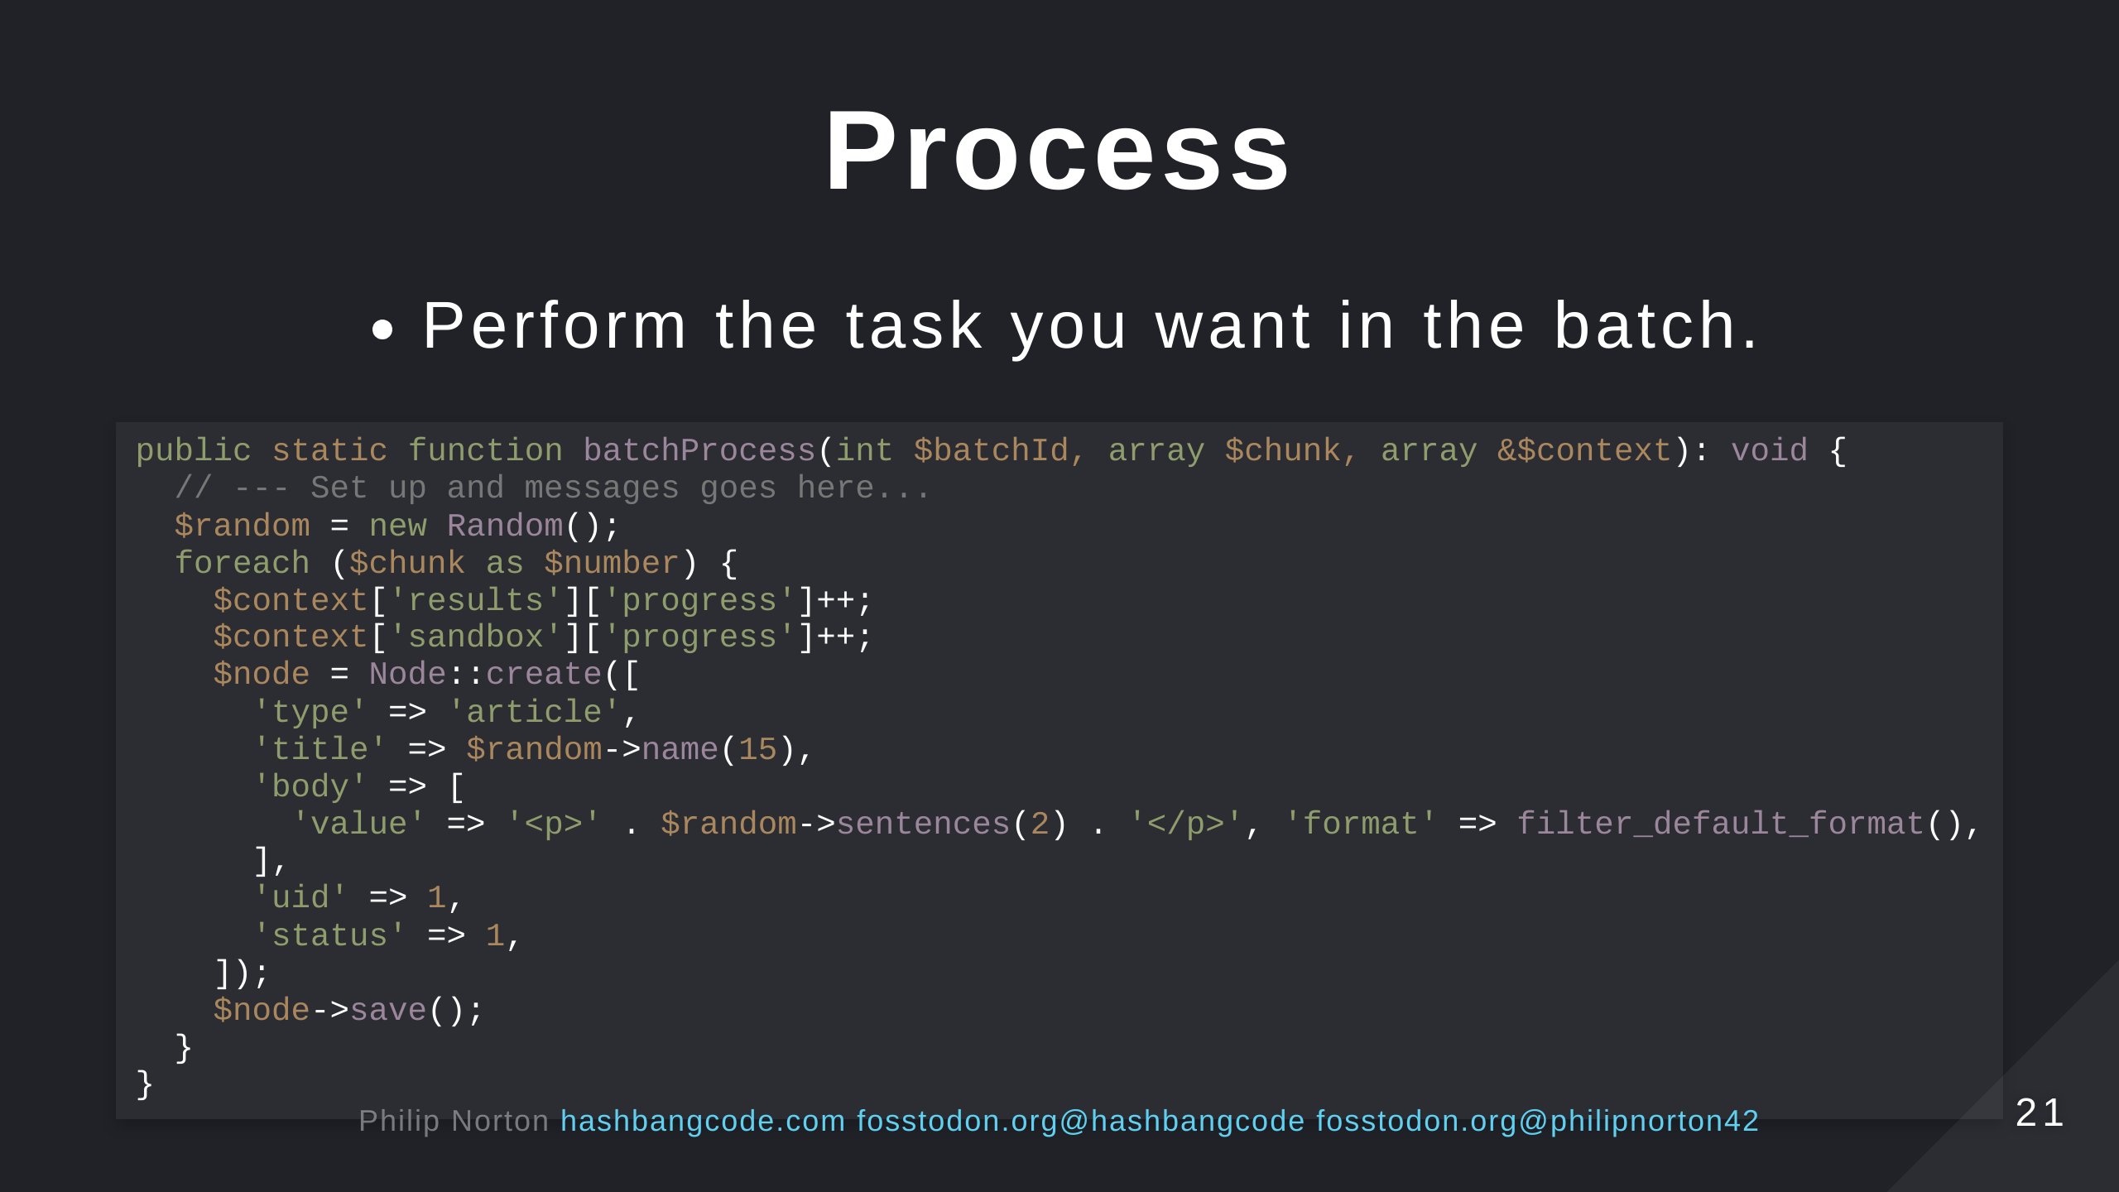
Notes:
- This creates 1,000 nodes based on the chunks of 100 items from the setup.

Slide 22
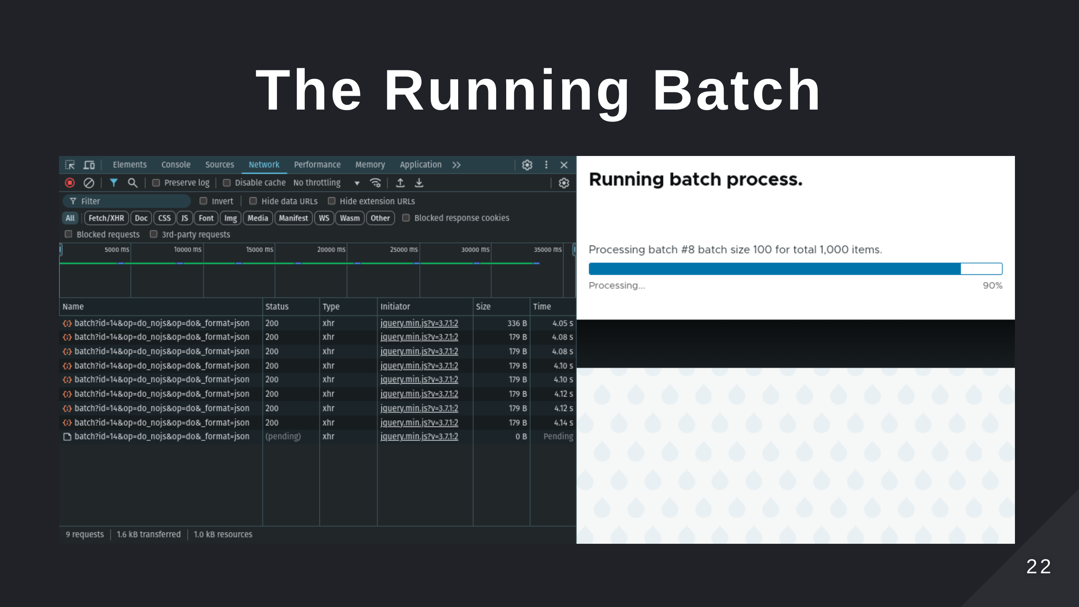
Notes:
- This handles the processing of the batch operations. - JavaScript calls the /batch endpoint. - This then responds with the result of a batch run. - You still need to keep each individual process operation small.

Slide 23
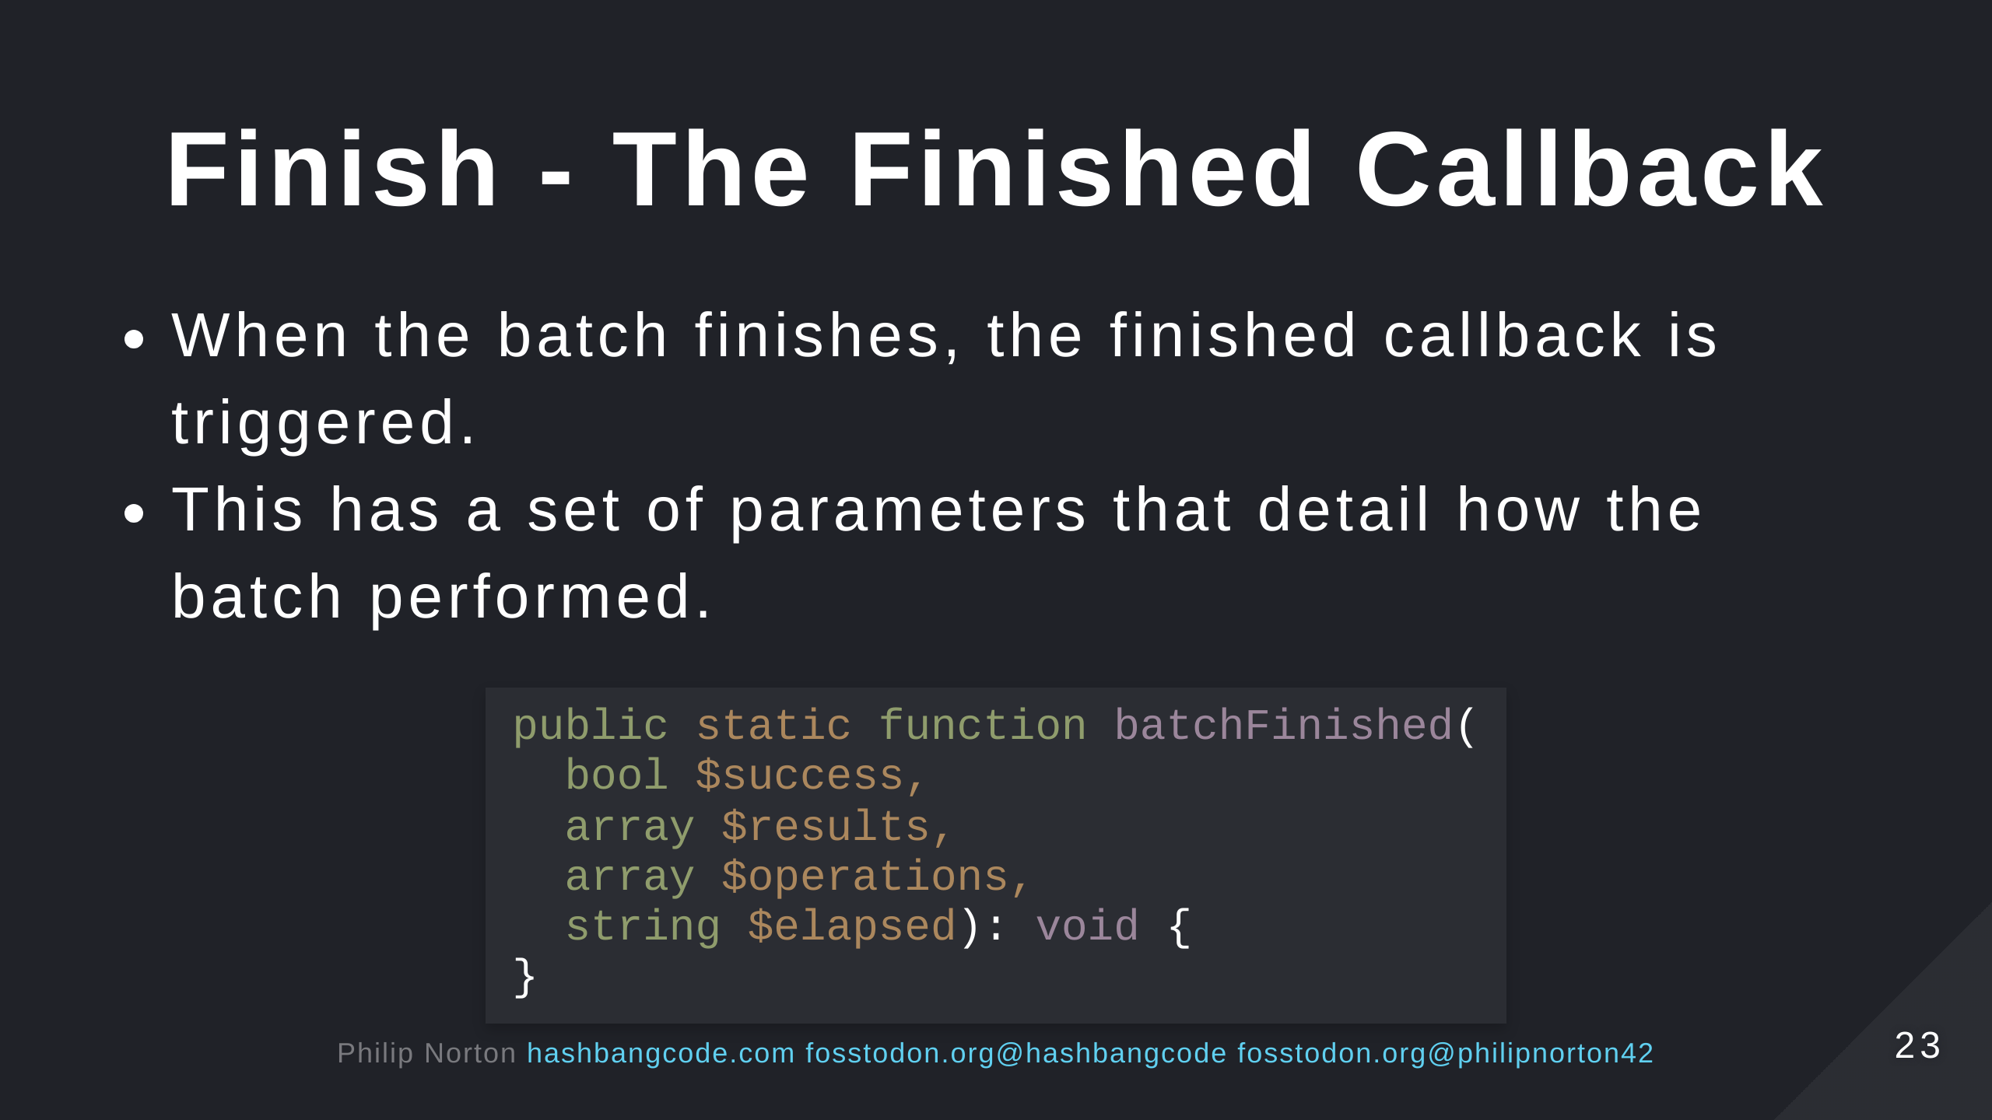
Notes:
- $success - TRUE if all batch API tasks were completed successfully. - $results - An results array from the batch processing operations. - $operations - A list of the operations that had not been completed. - $elapsed - Batch.inc kindly provides the elapsed processing time in seconds.

Slide 24
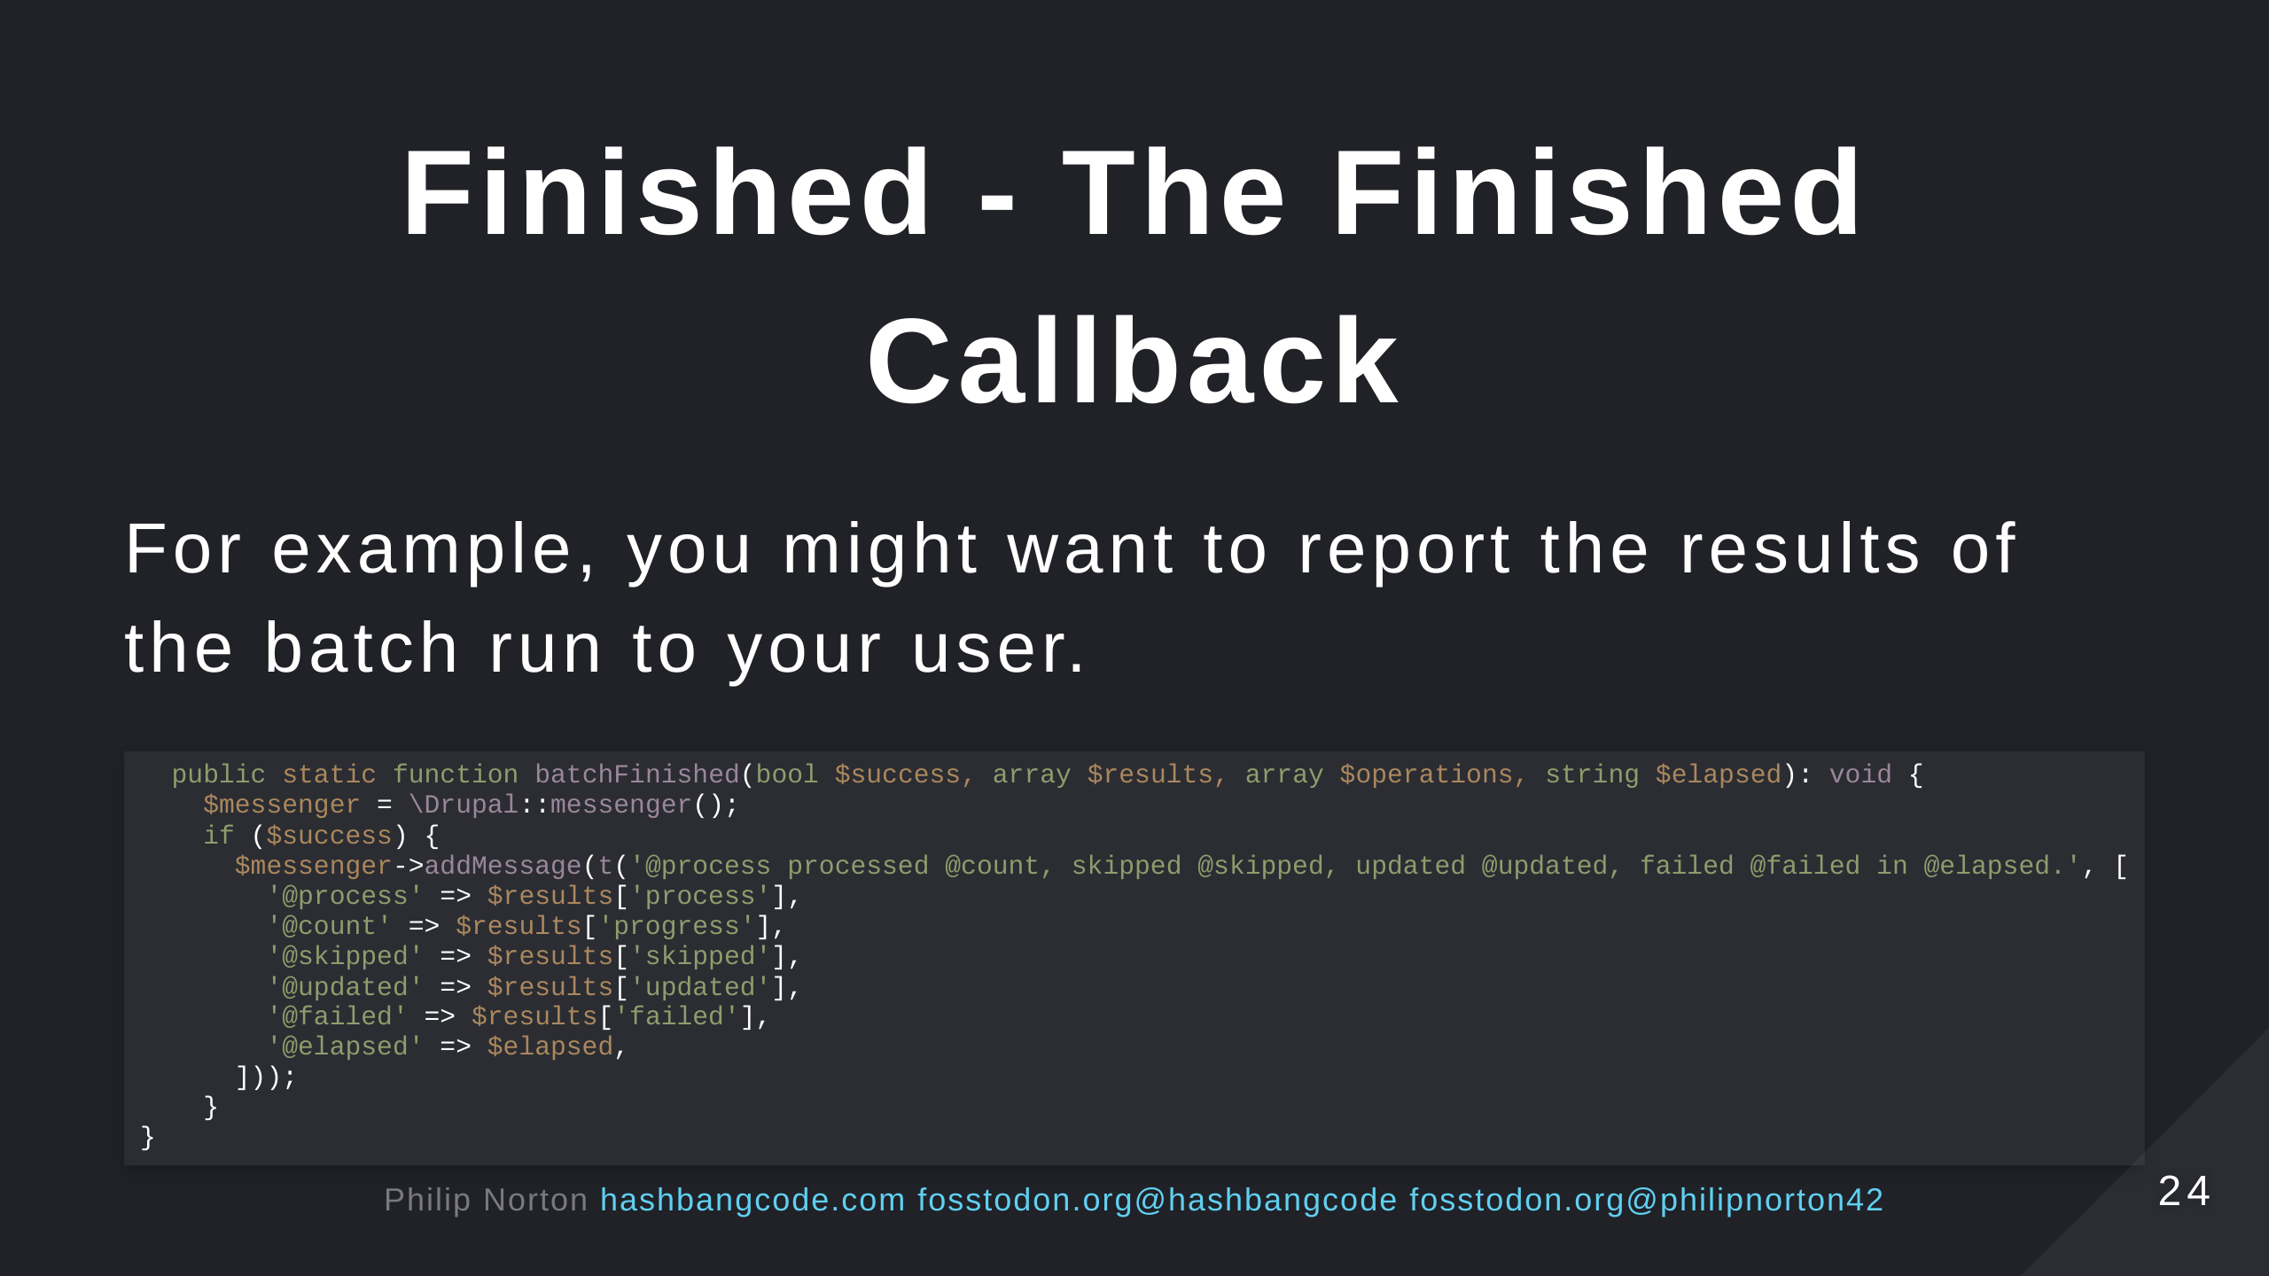

Slide 25
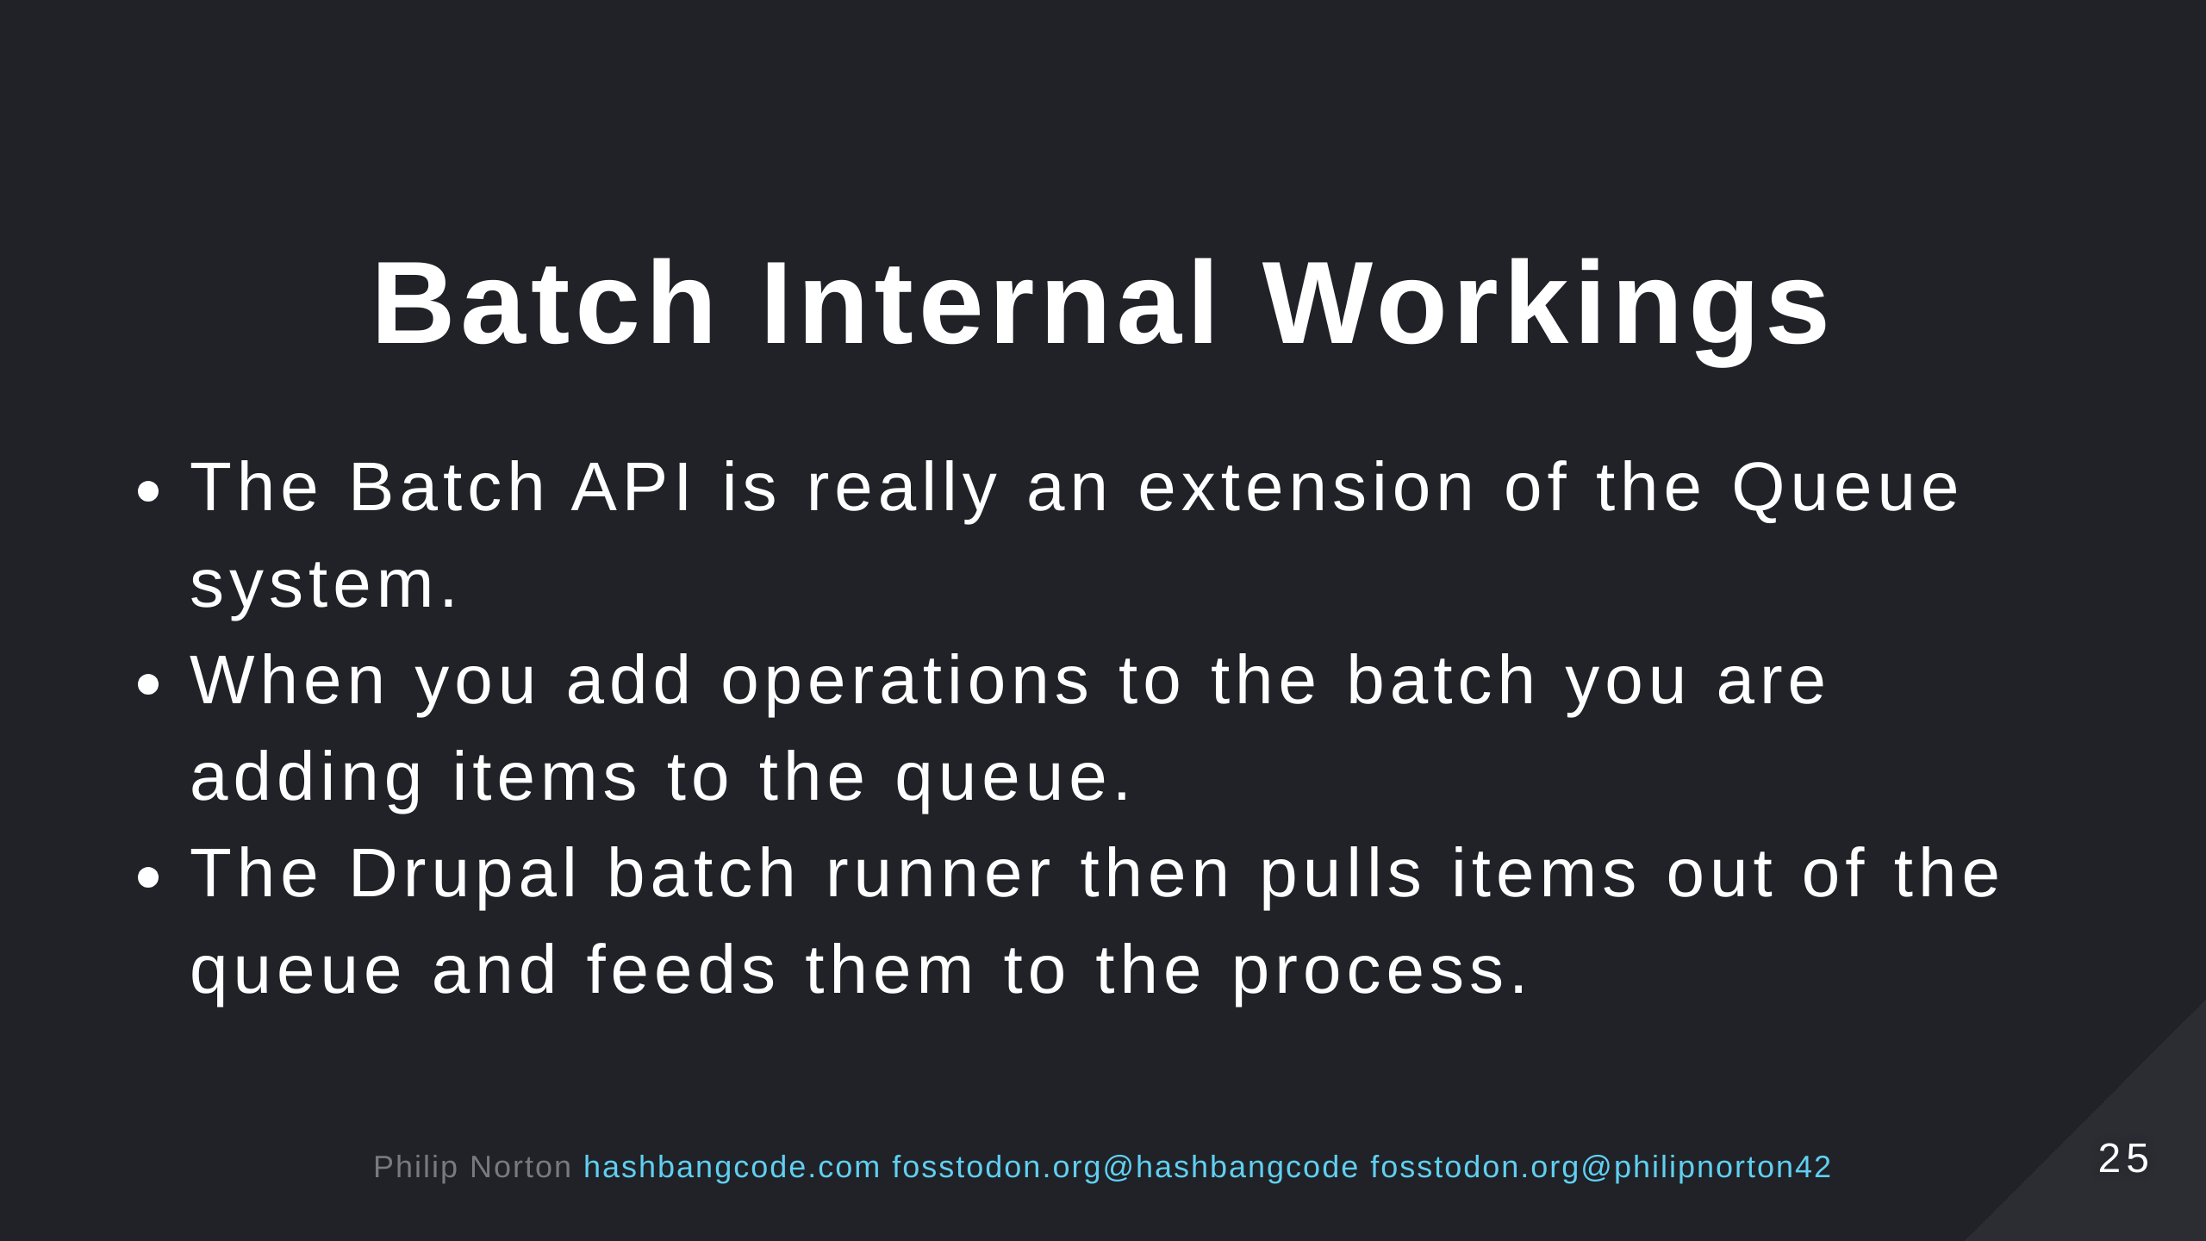

Slide 26
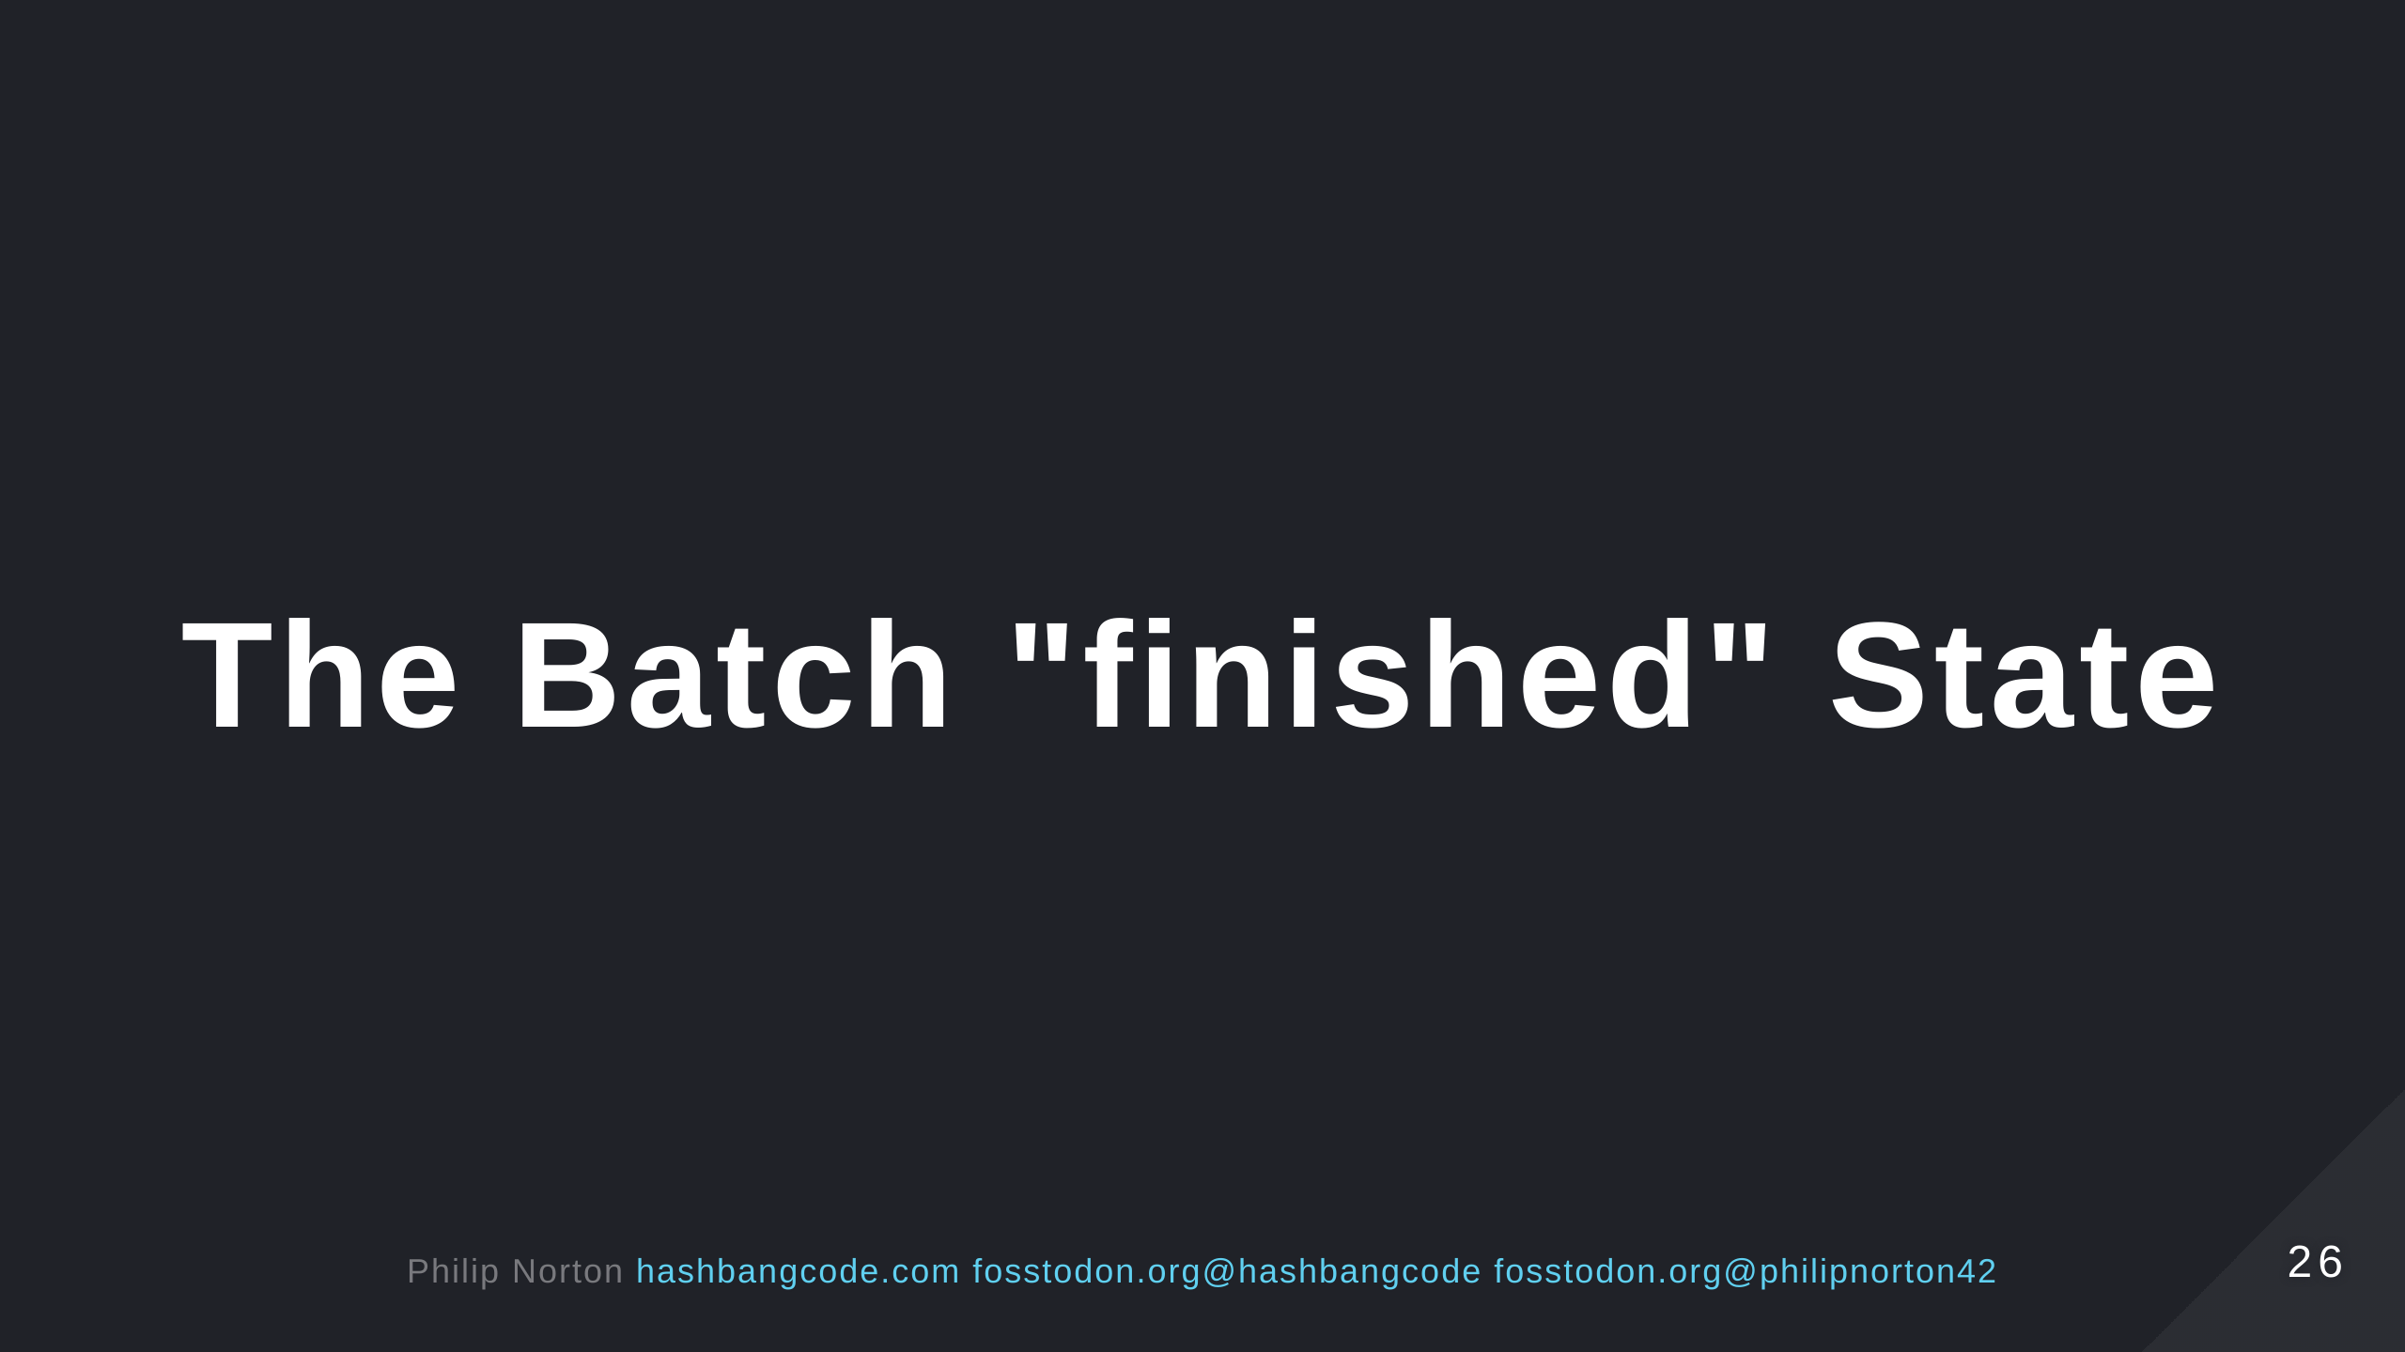

Slide 27
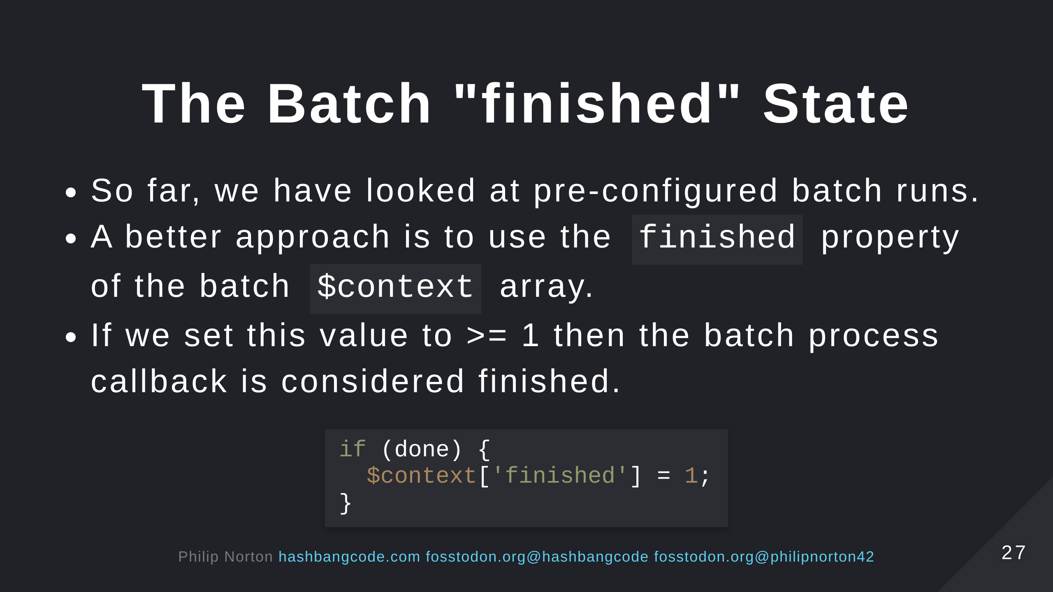

Slide 28
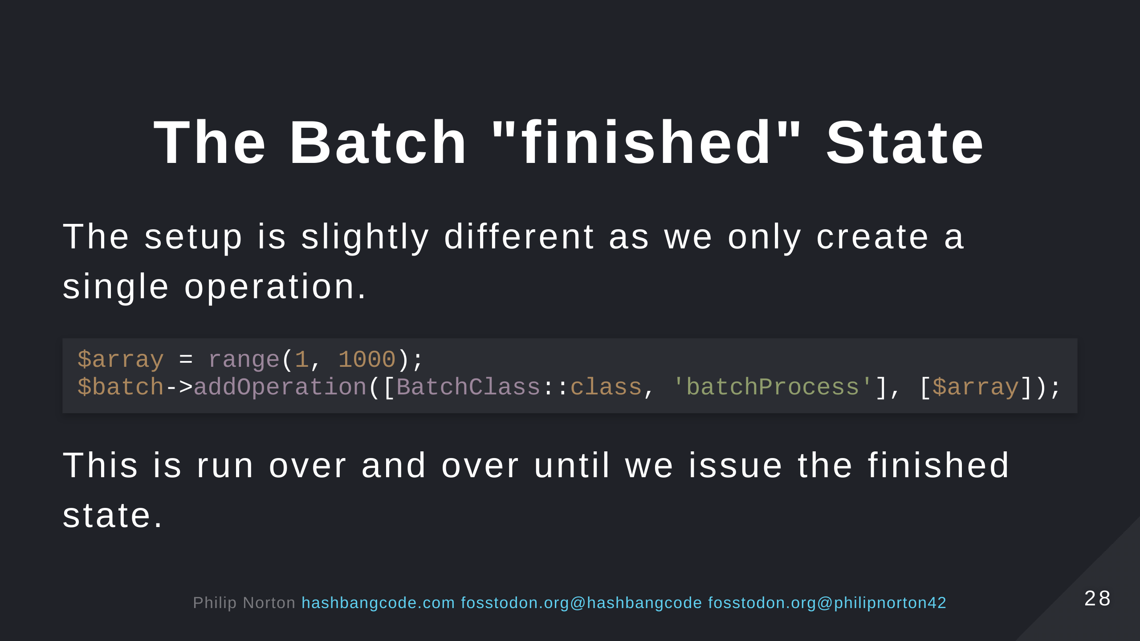

Slide 29
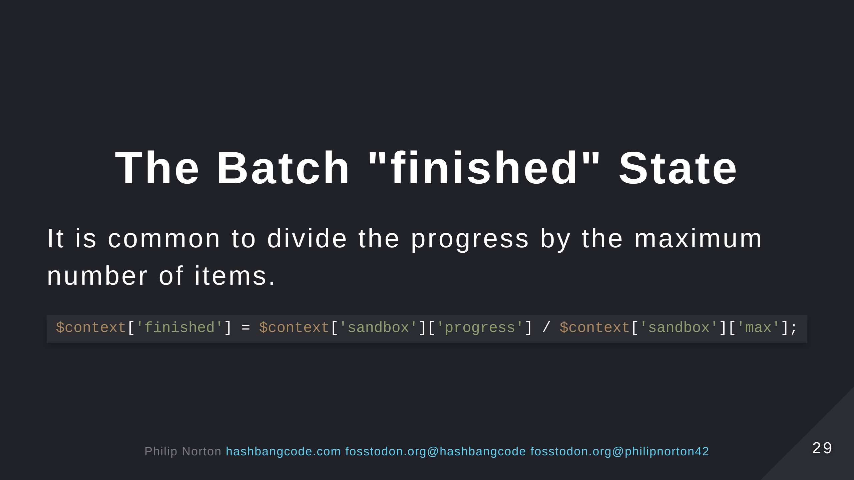

Slide 30
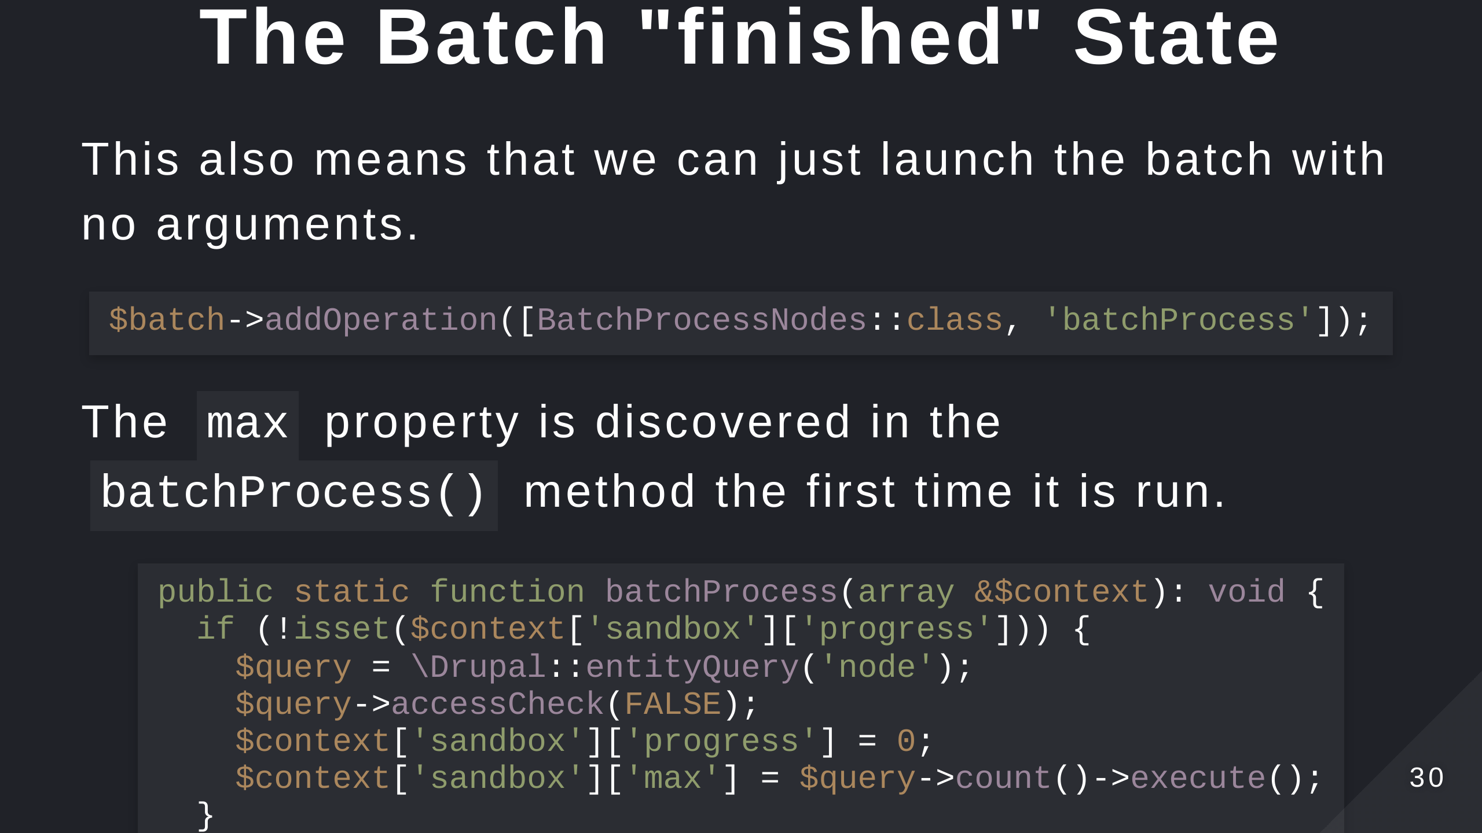

Slide 31
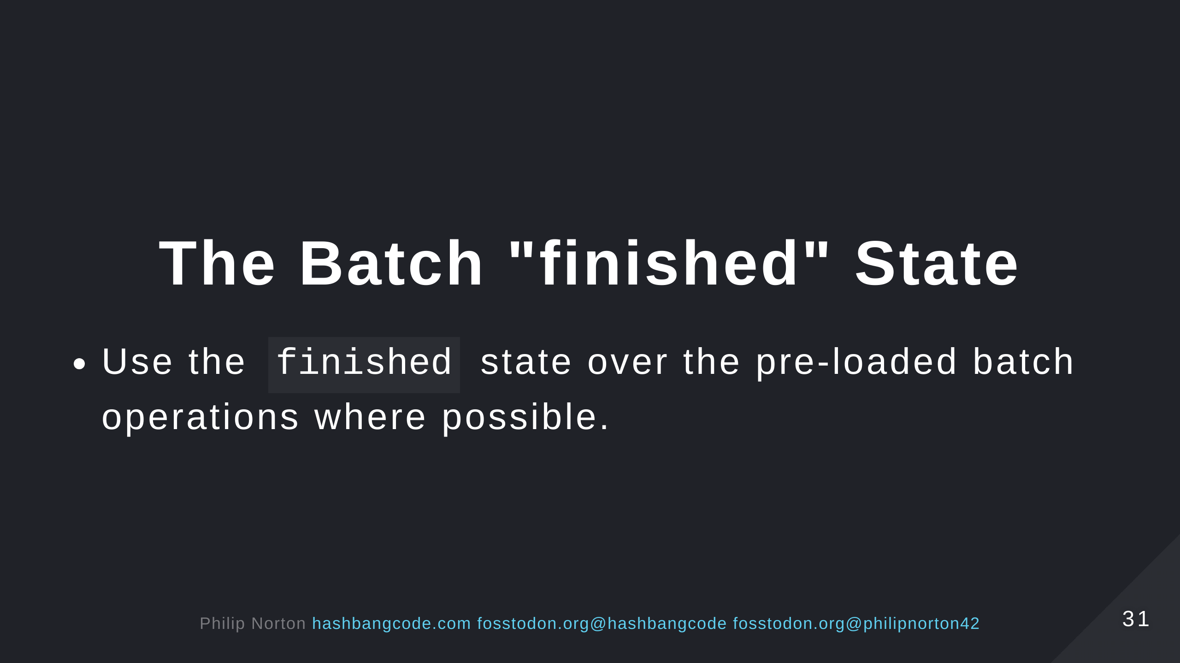

Slide 32
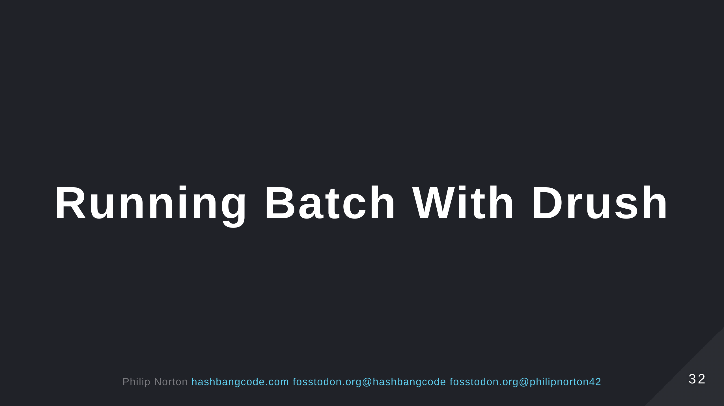

Slide 33
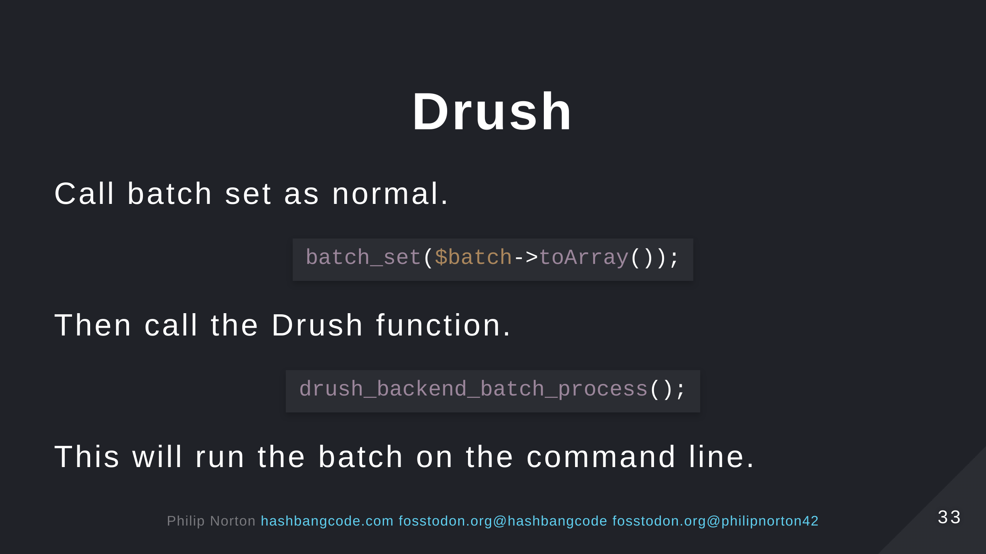

Slide 34
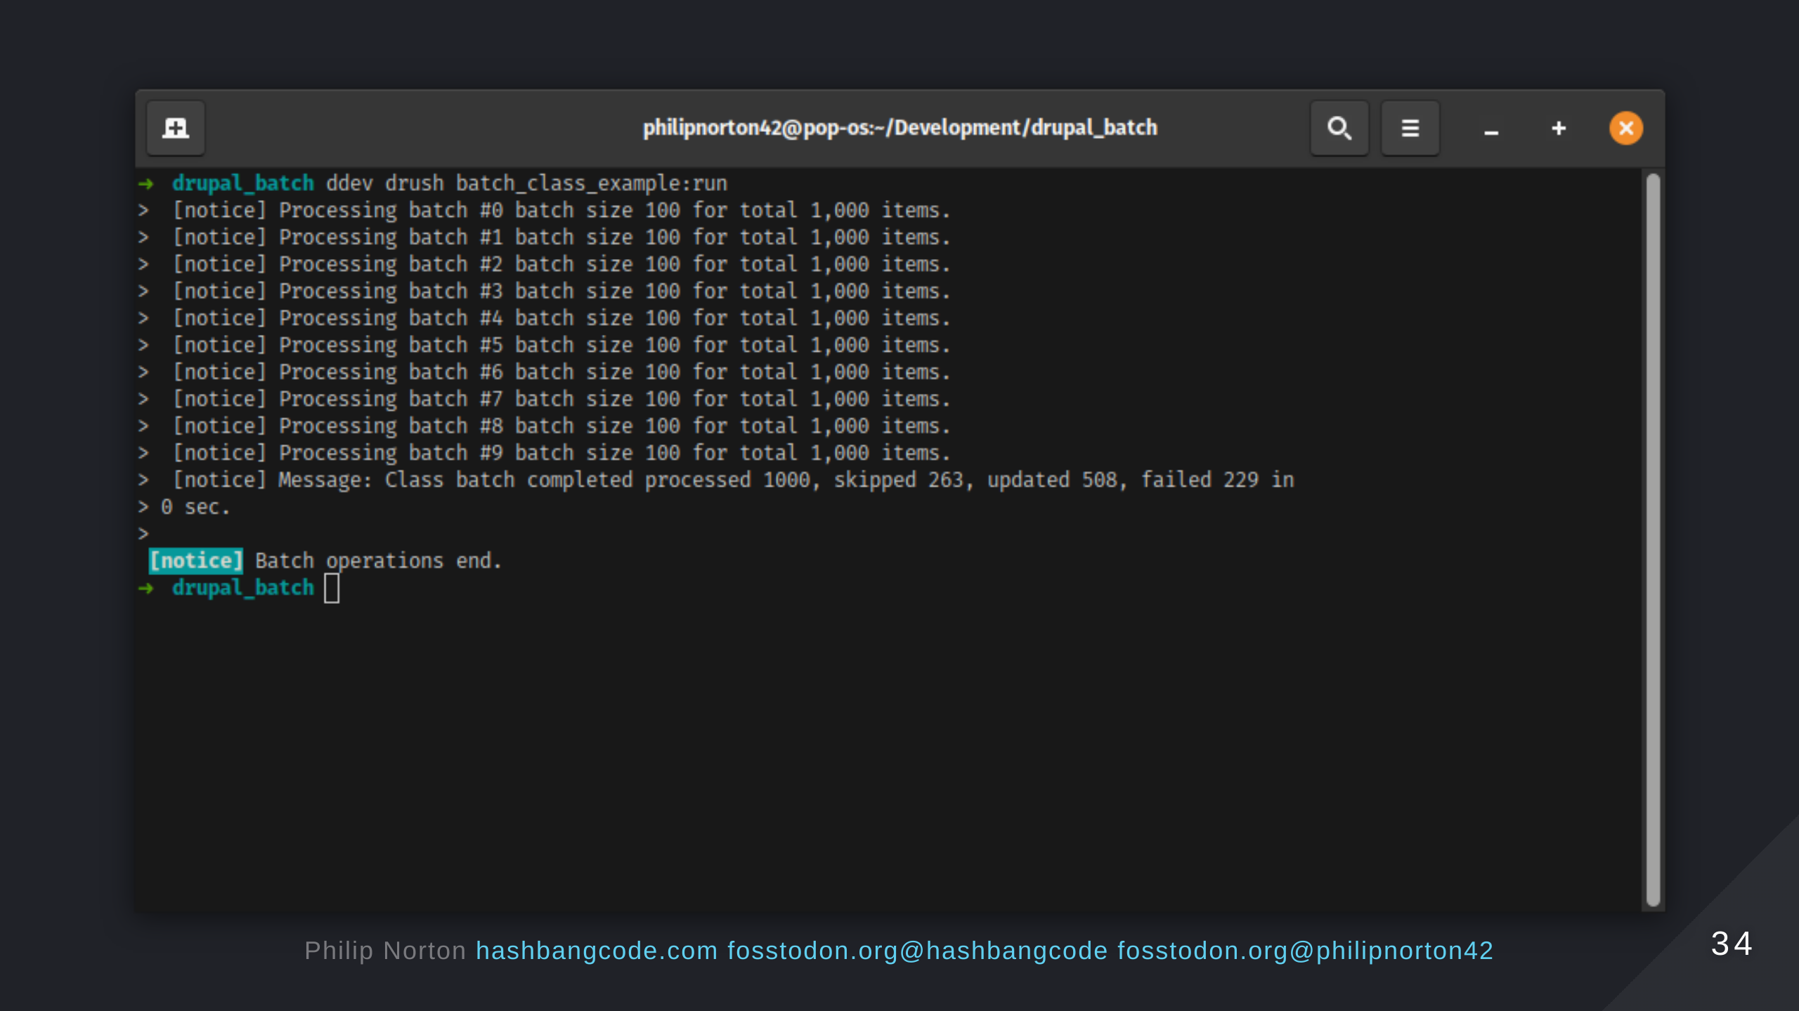

Slide 35
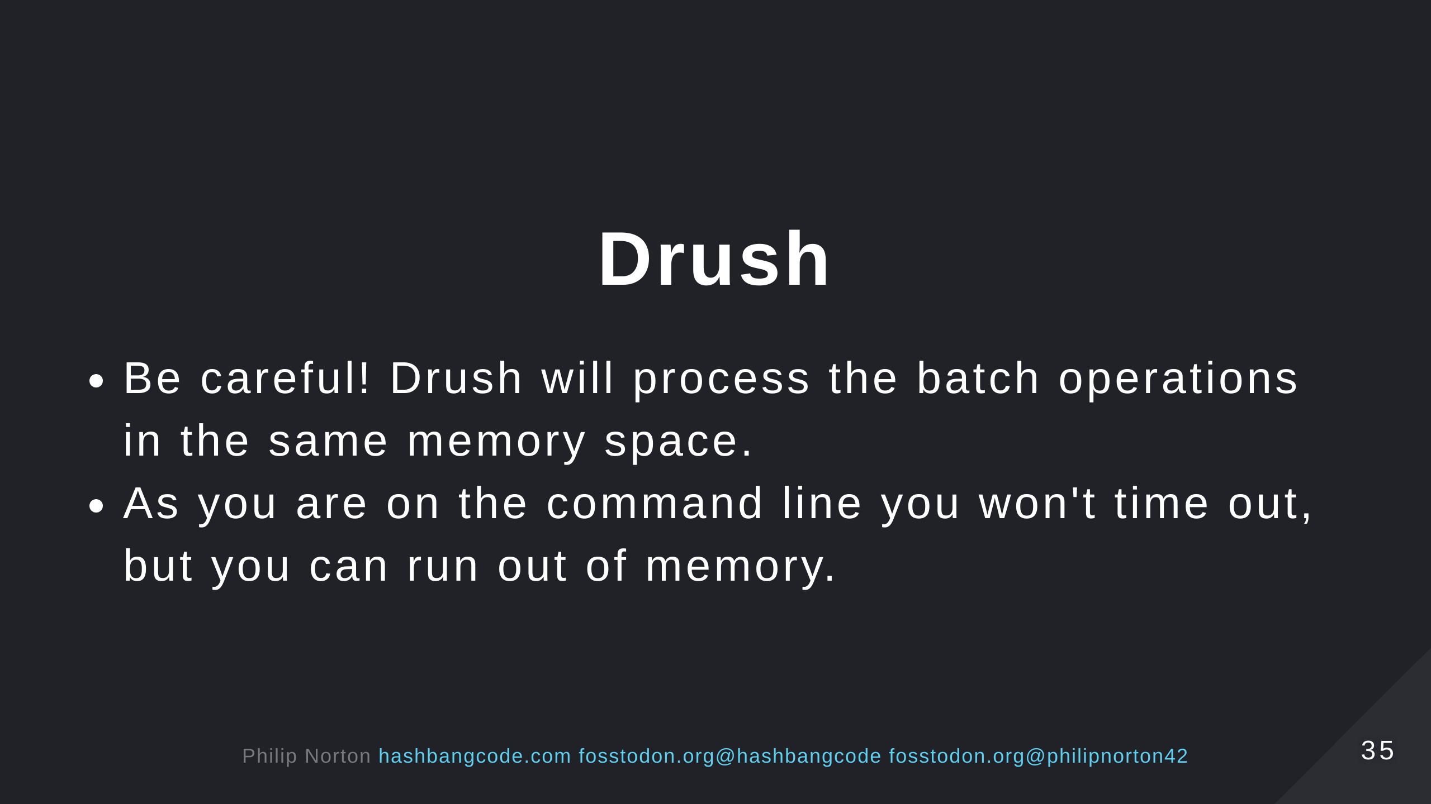
Notes:
- You may see timeouts, it depends on your server setup. - Generally, CLI has unlimited processing time for operations.

Slide 36
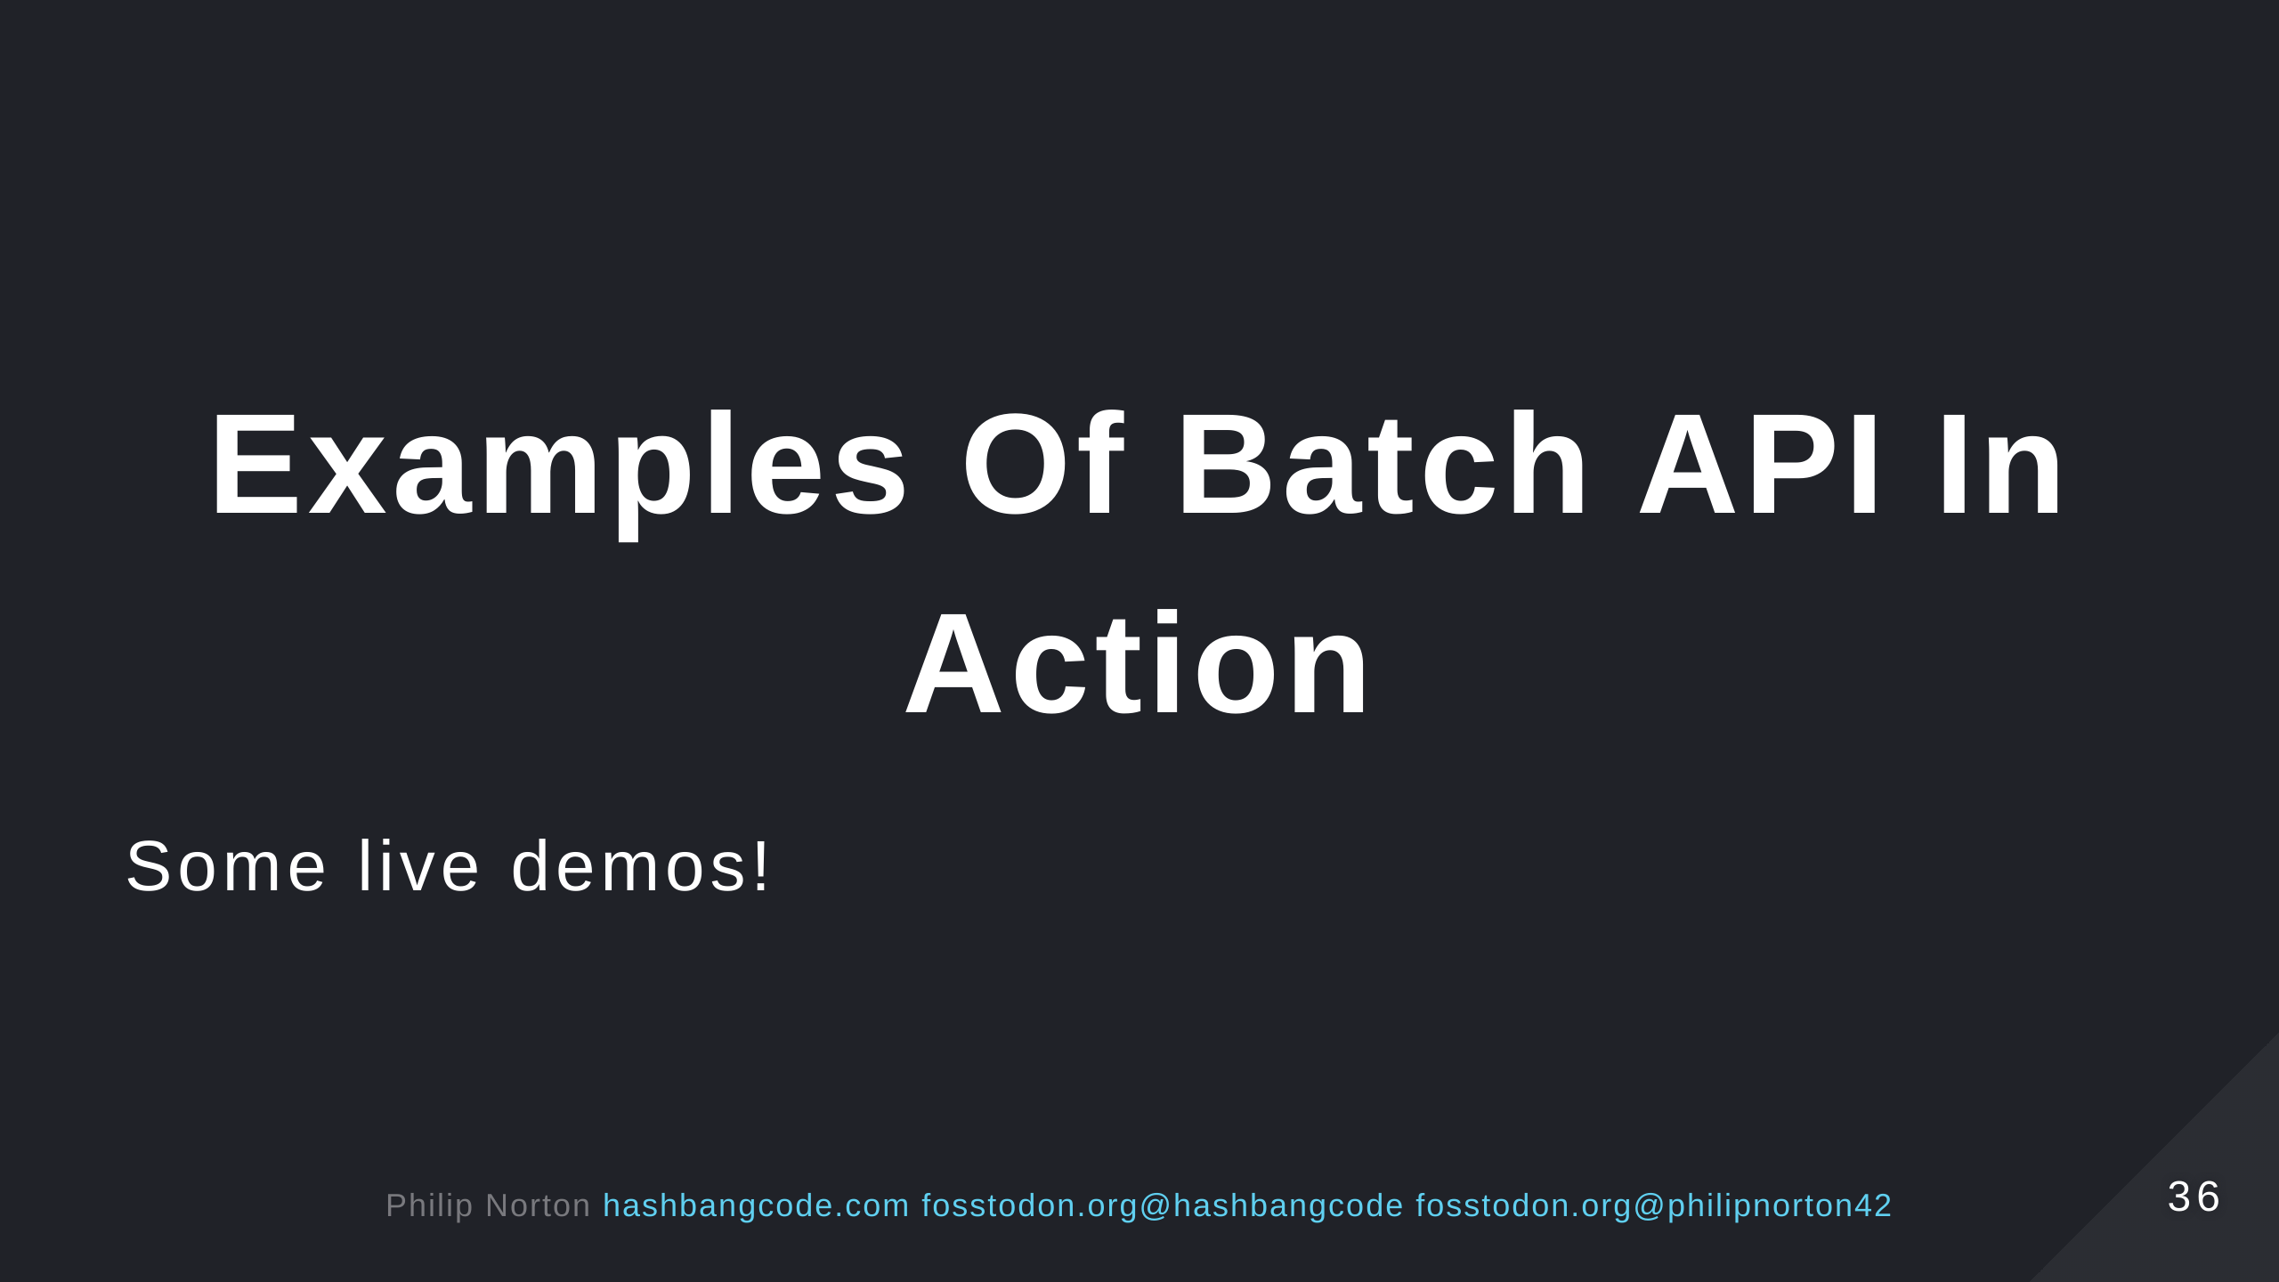

Slide 37
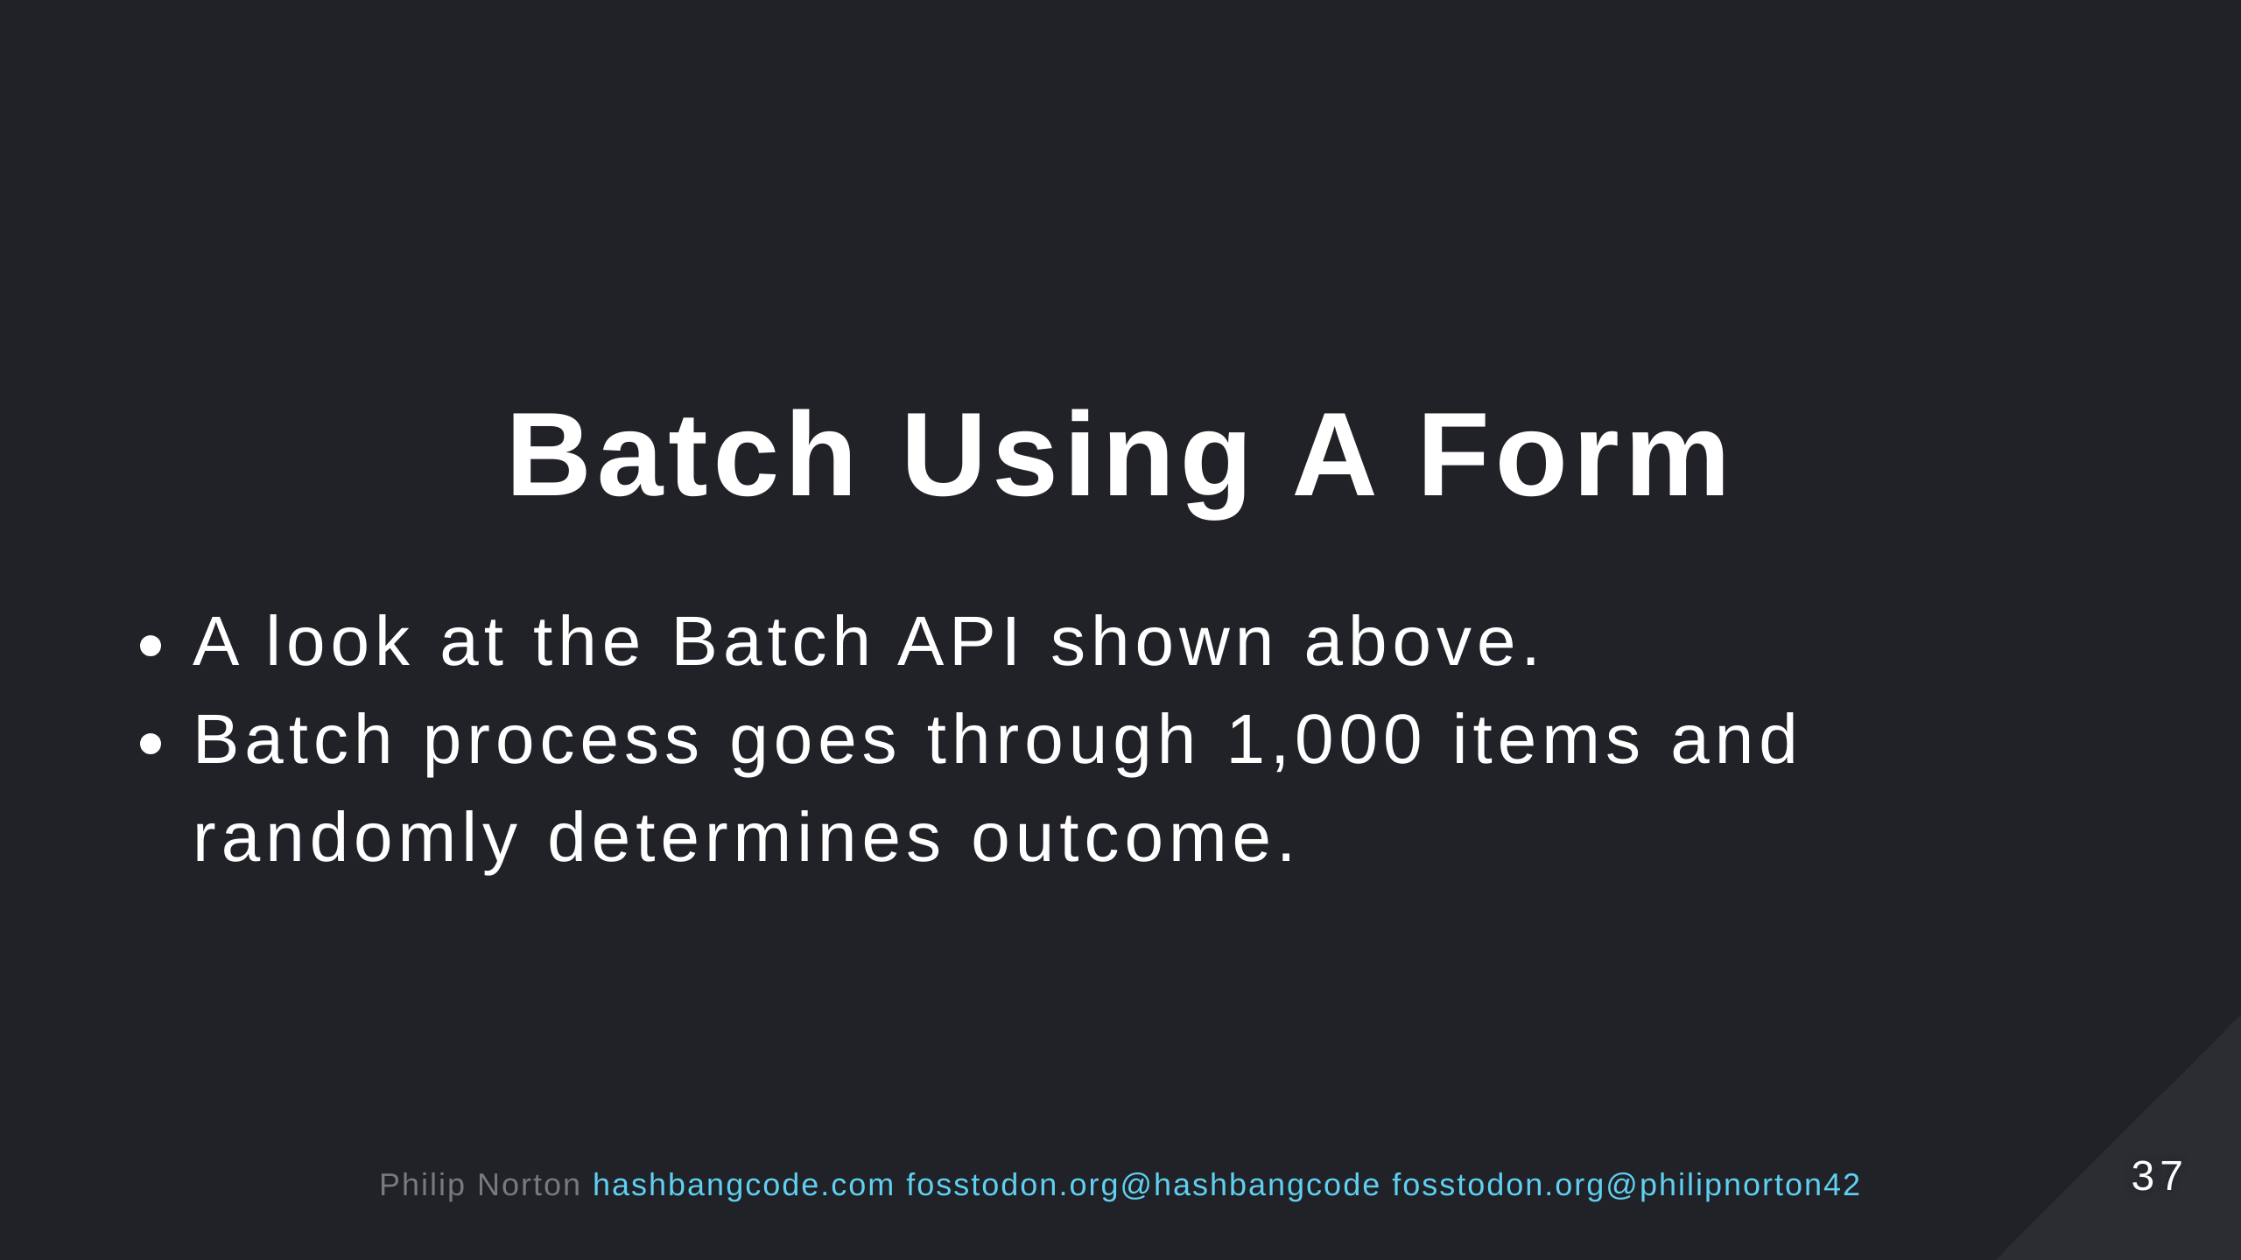

Slide 38
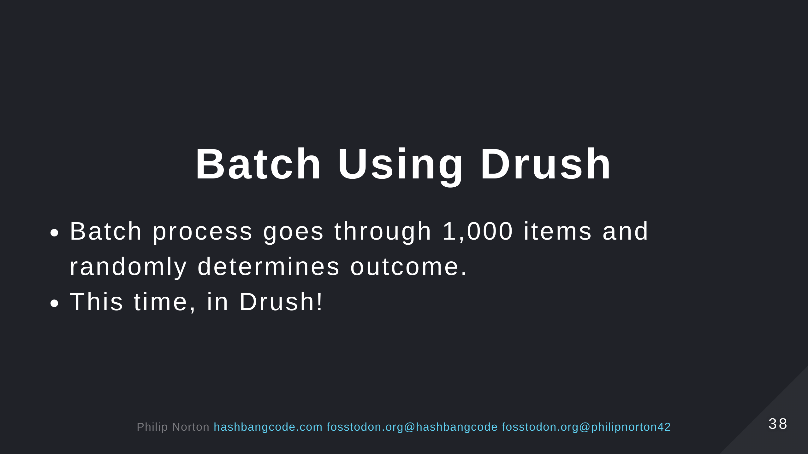

Slide 39
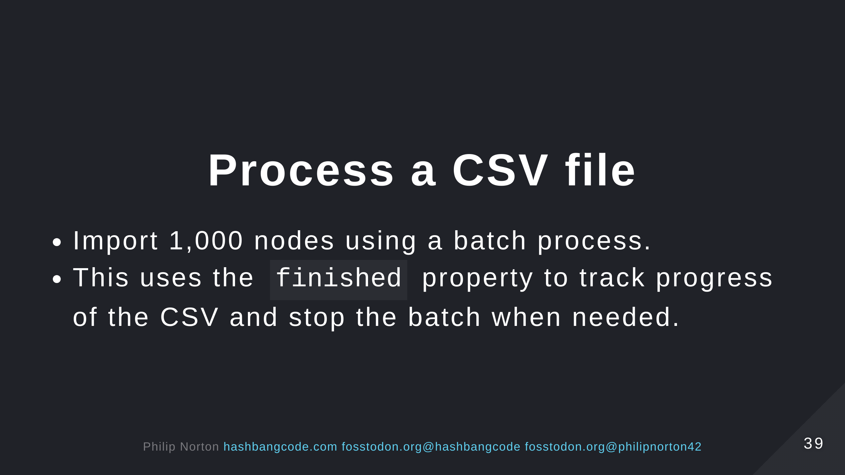

Slide 40
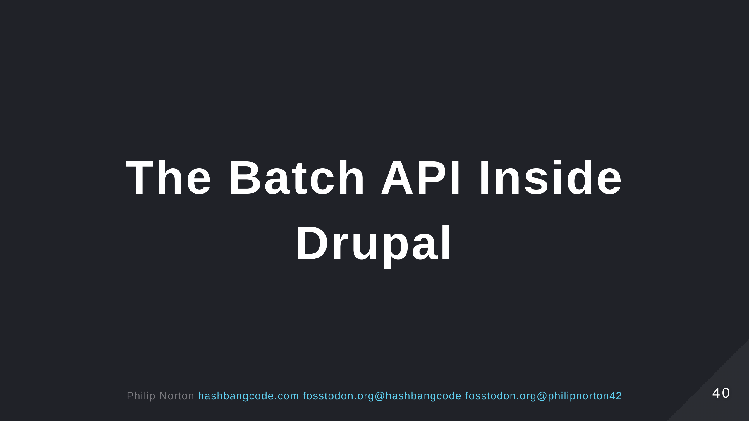

Slide 41
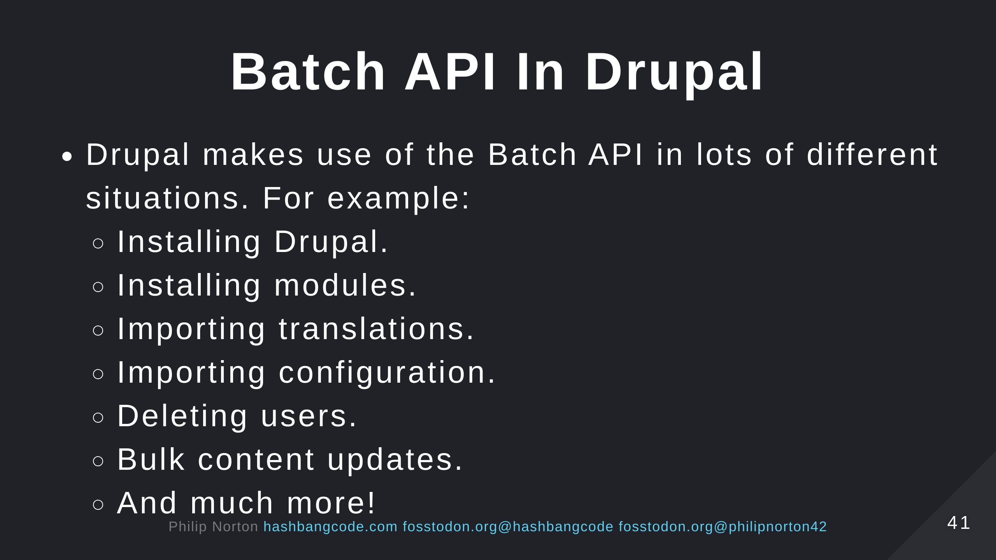
Notes:
- Look for the progress bar. This will mean you are running the Batch API to perform the work.

Slide 42
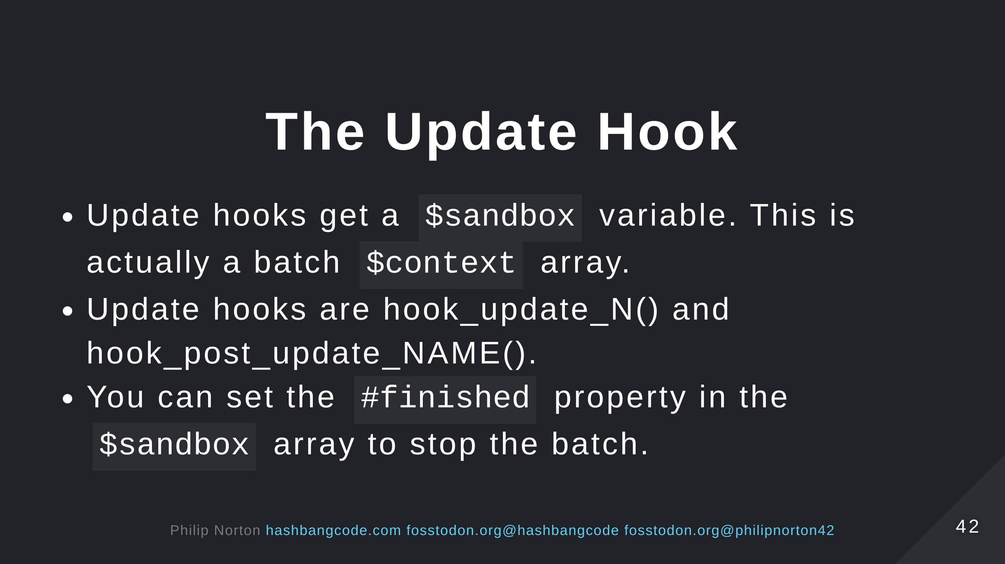
Notes:
- Note the hash in the finished property.

Slide 43
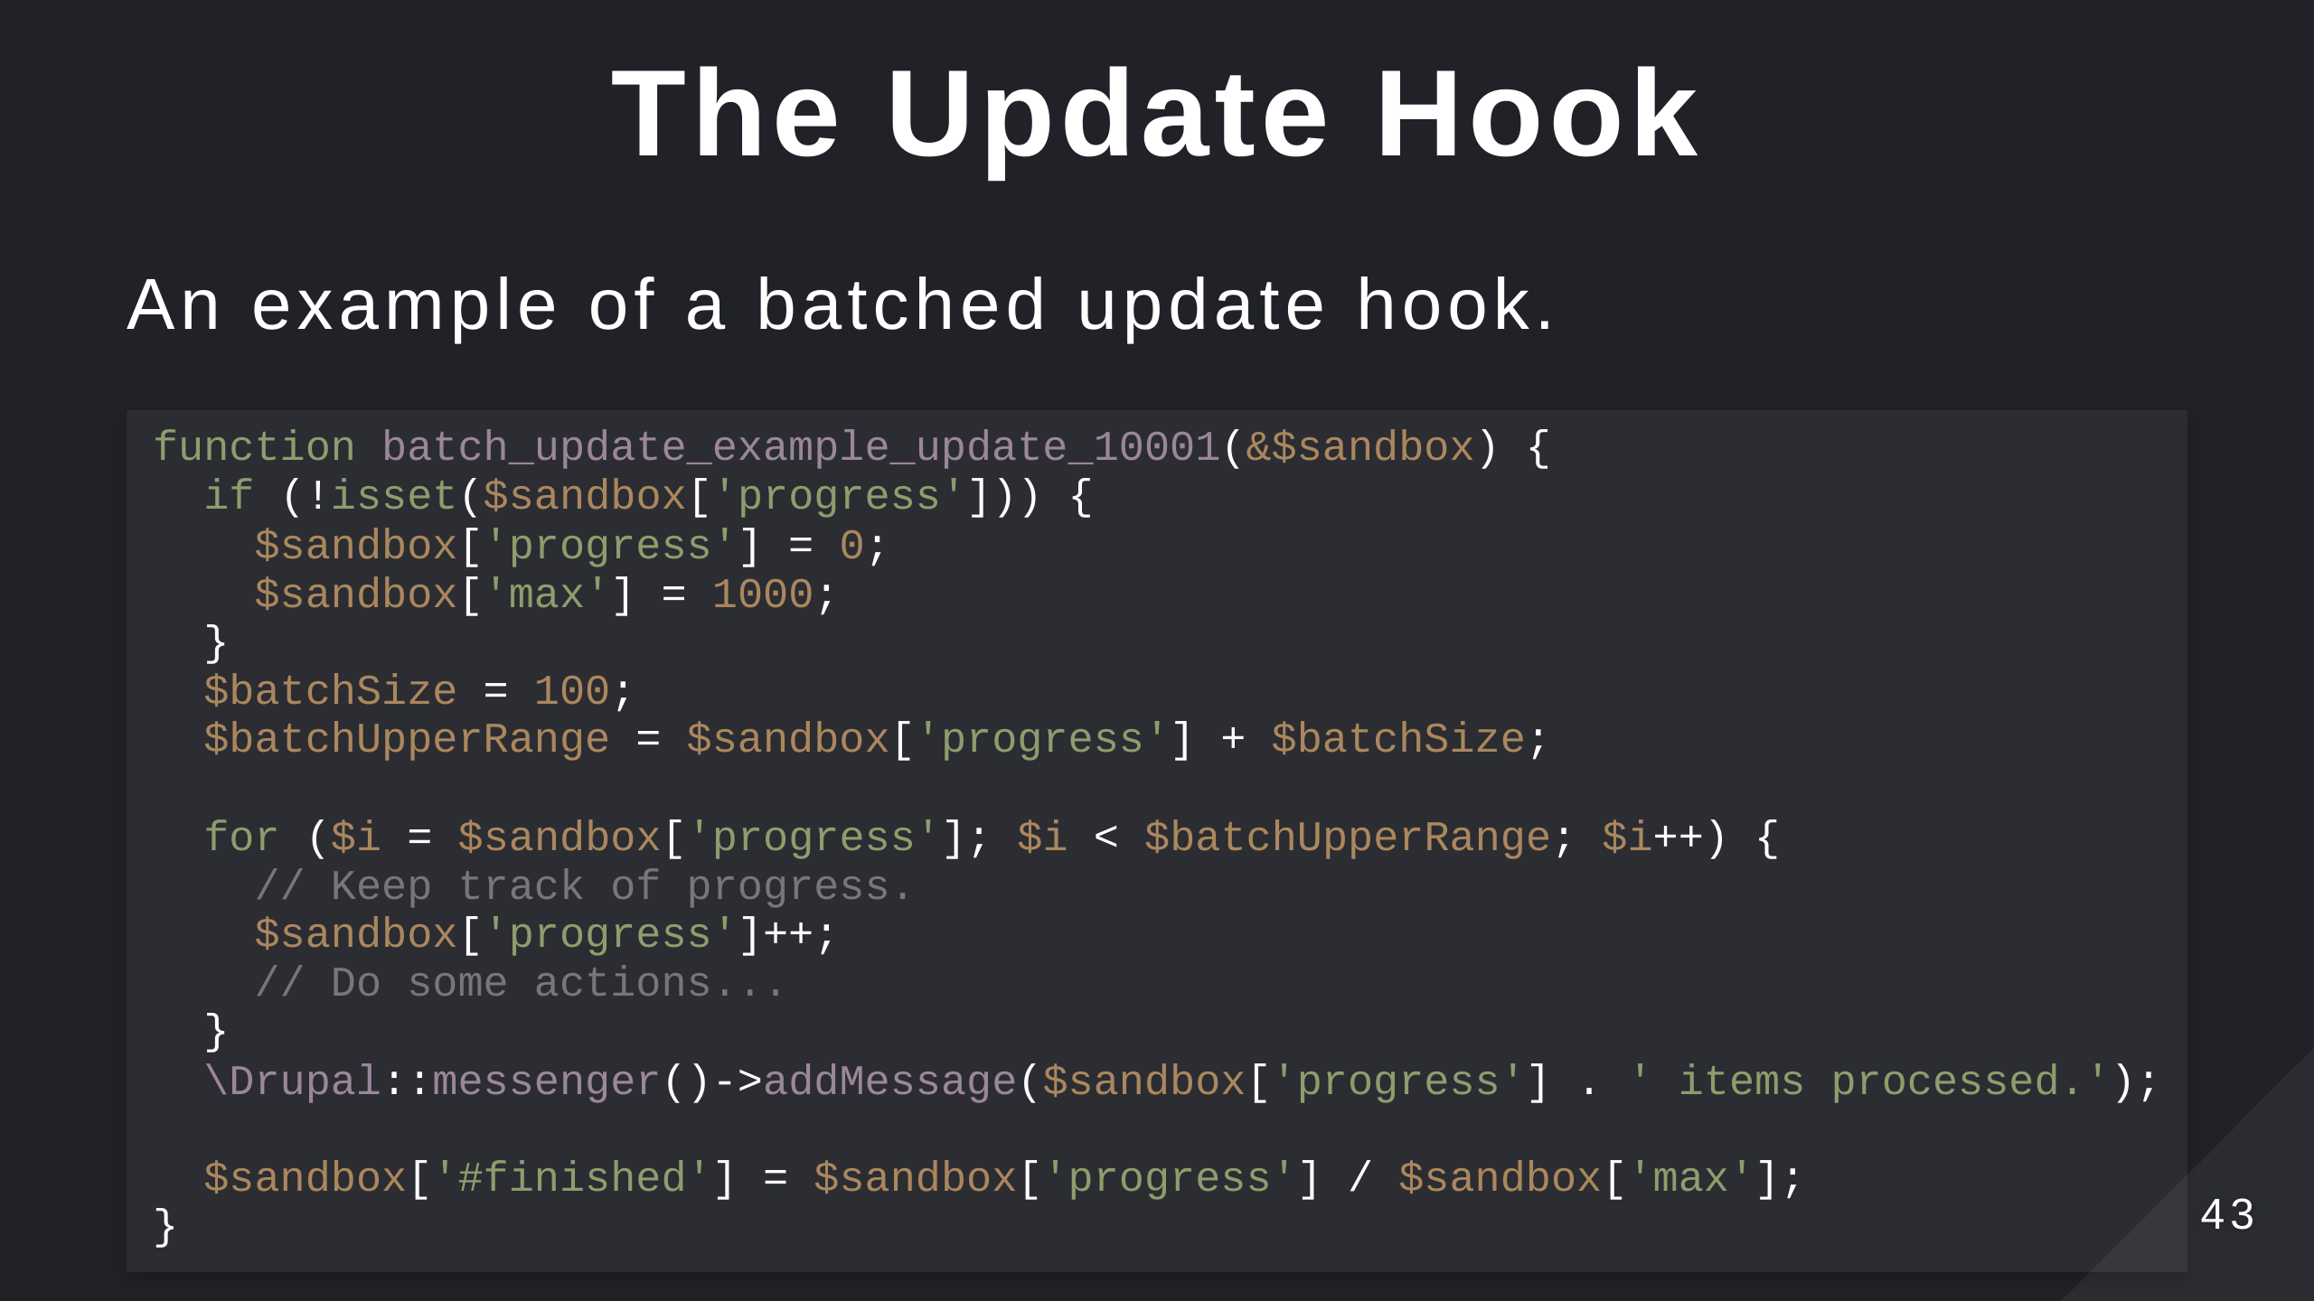

Slide 44
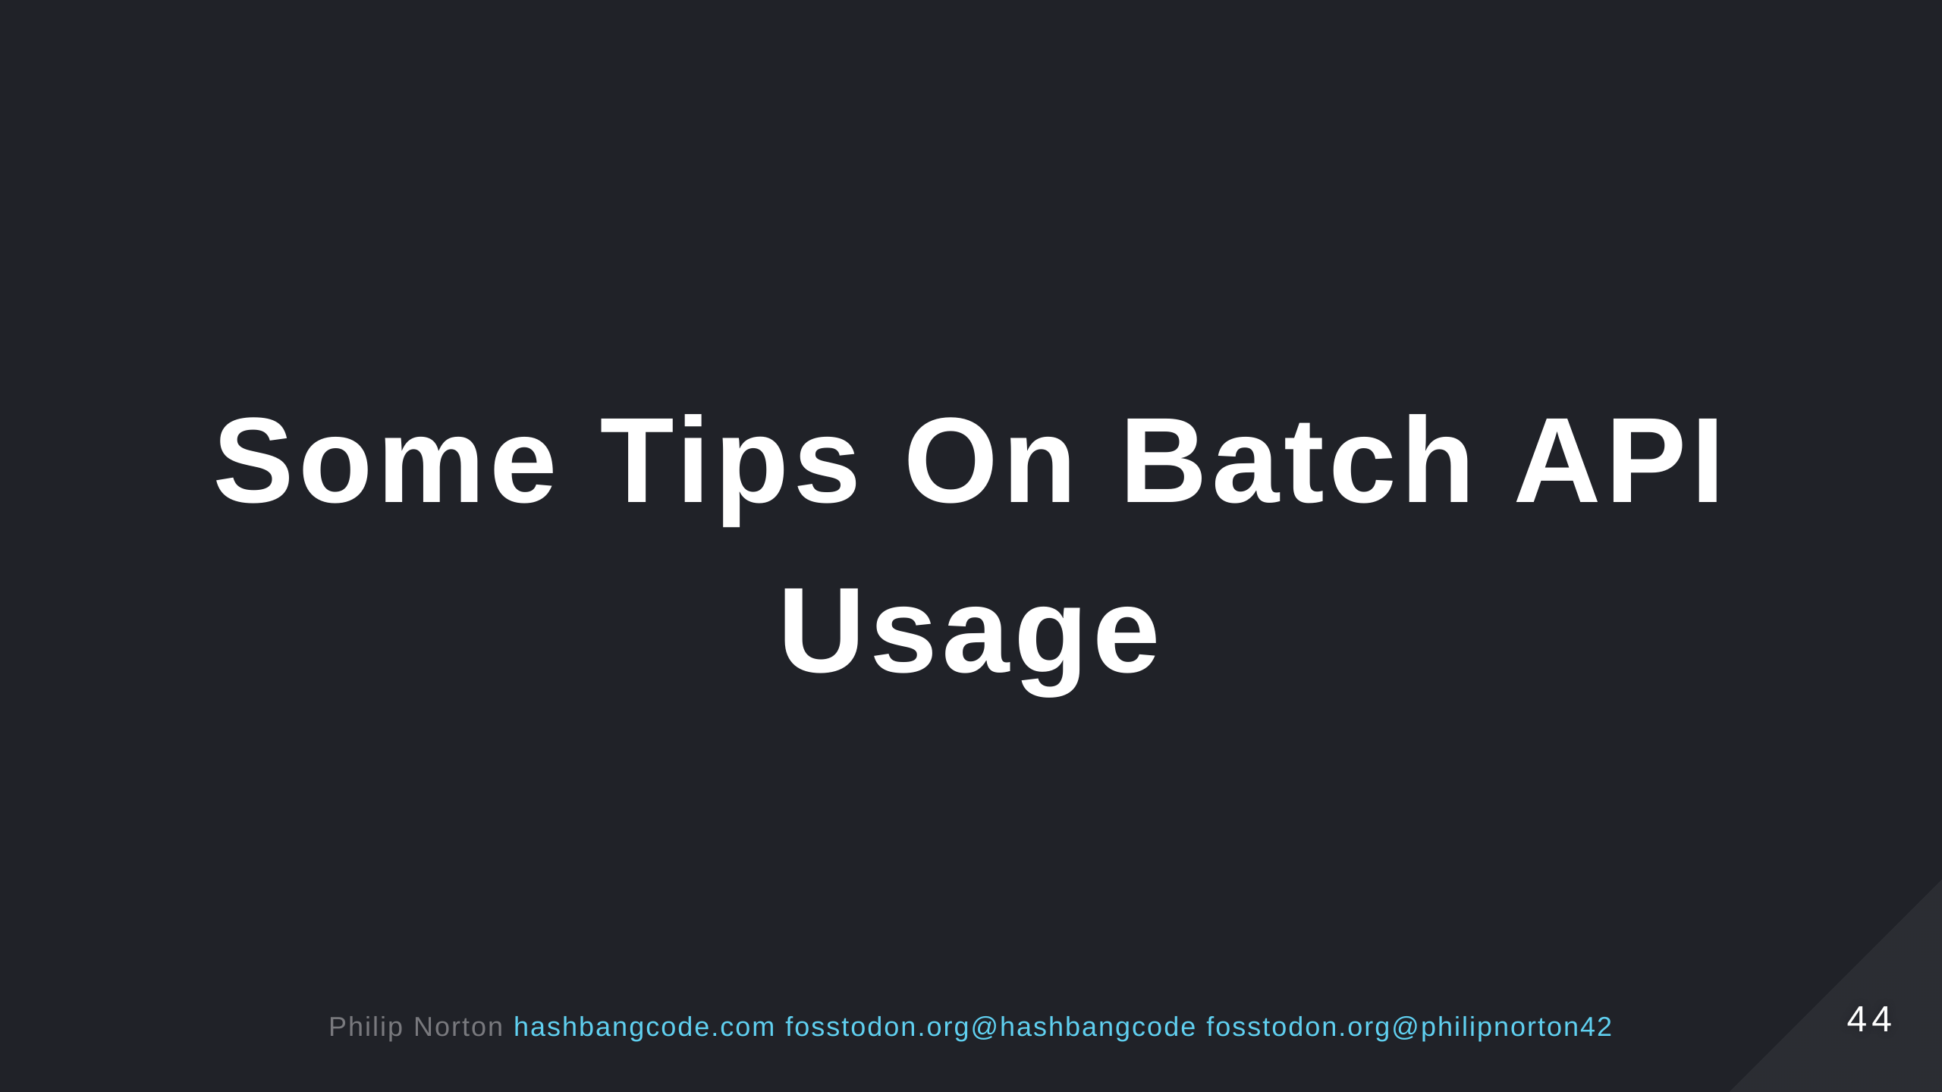

Slide 45
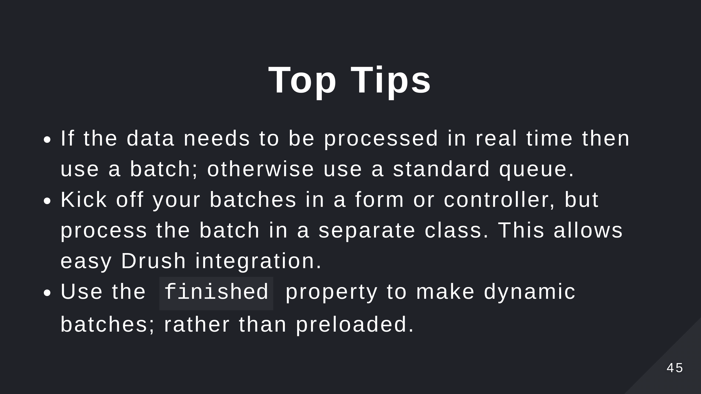

Slide 46
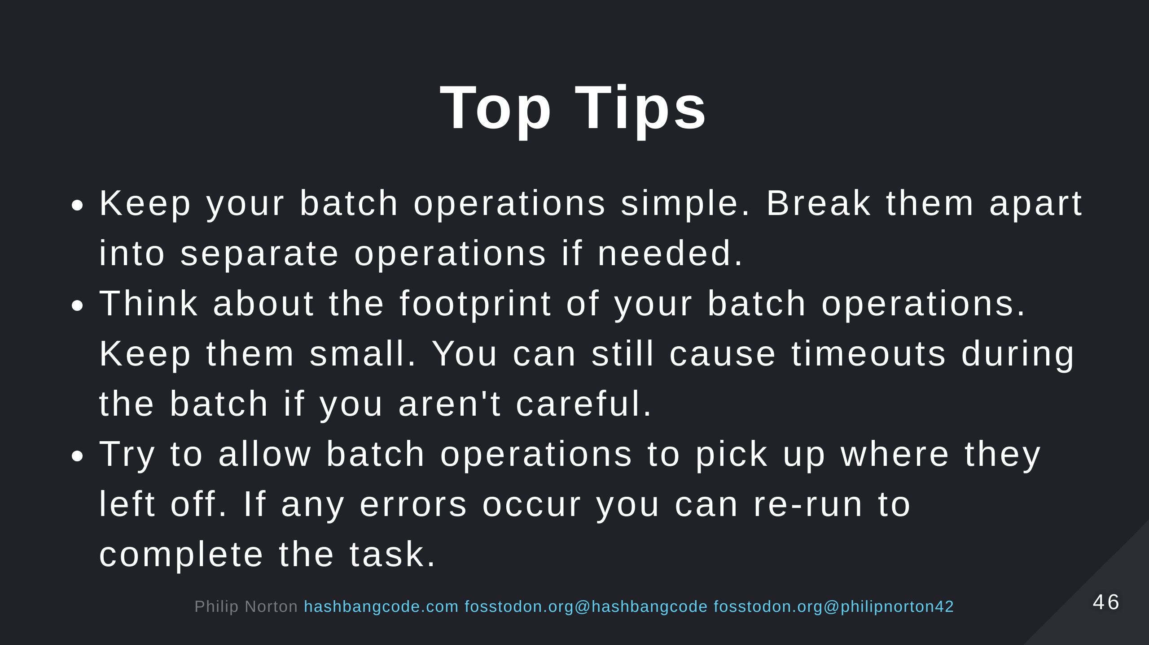

Slide 47
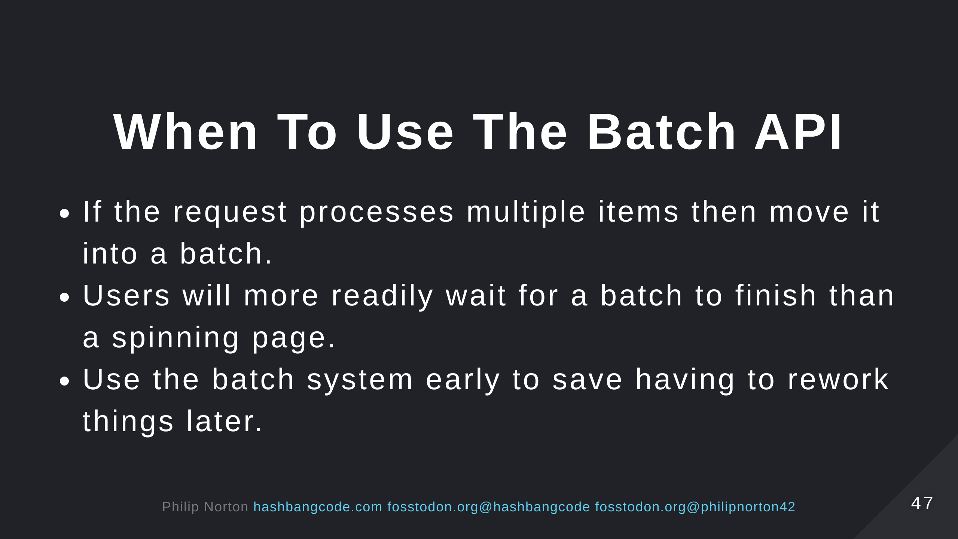

Slide 48
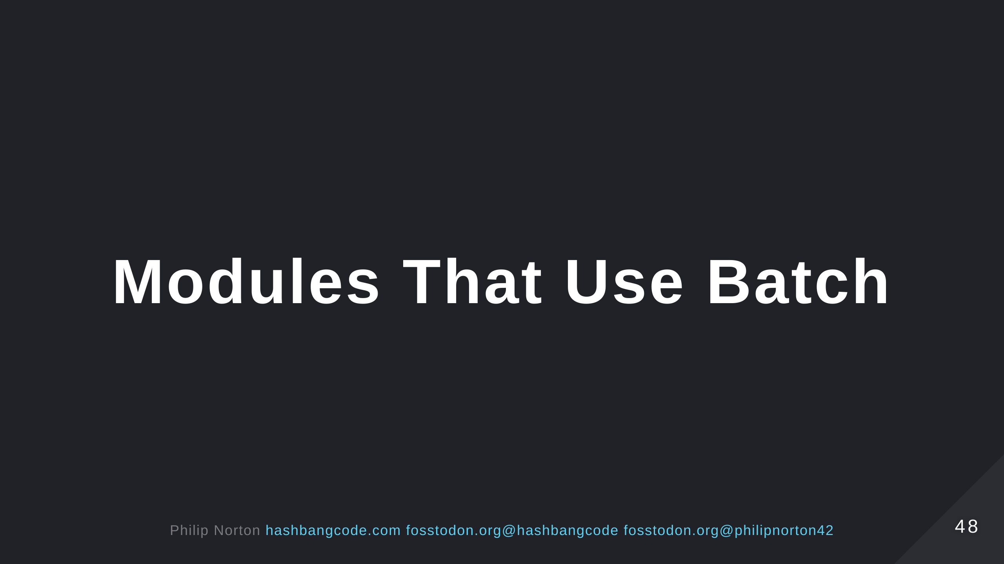

Slide 49
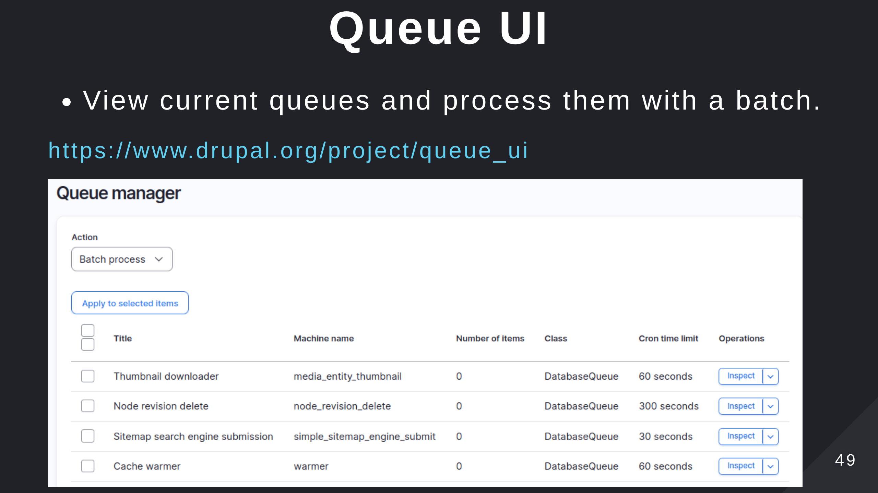

Slide 50
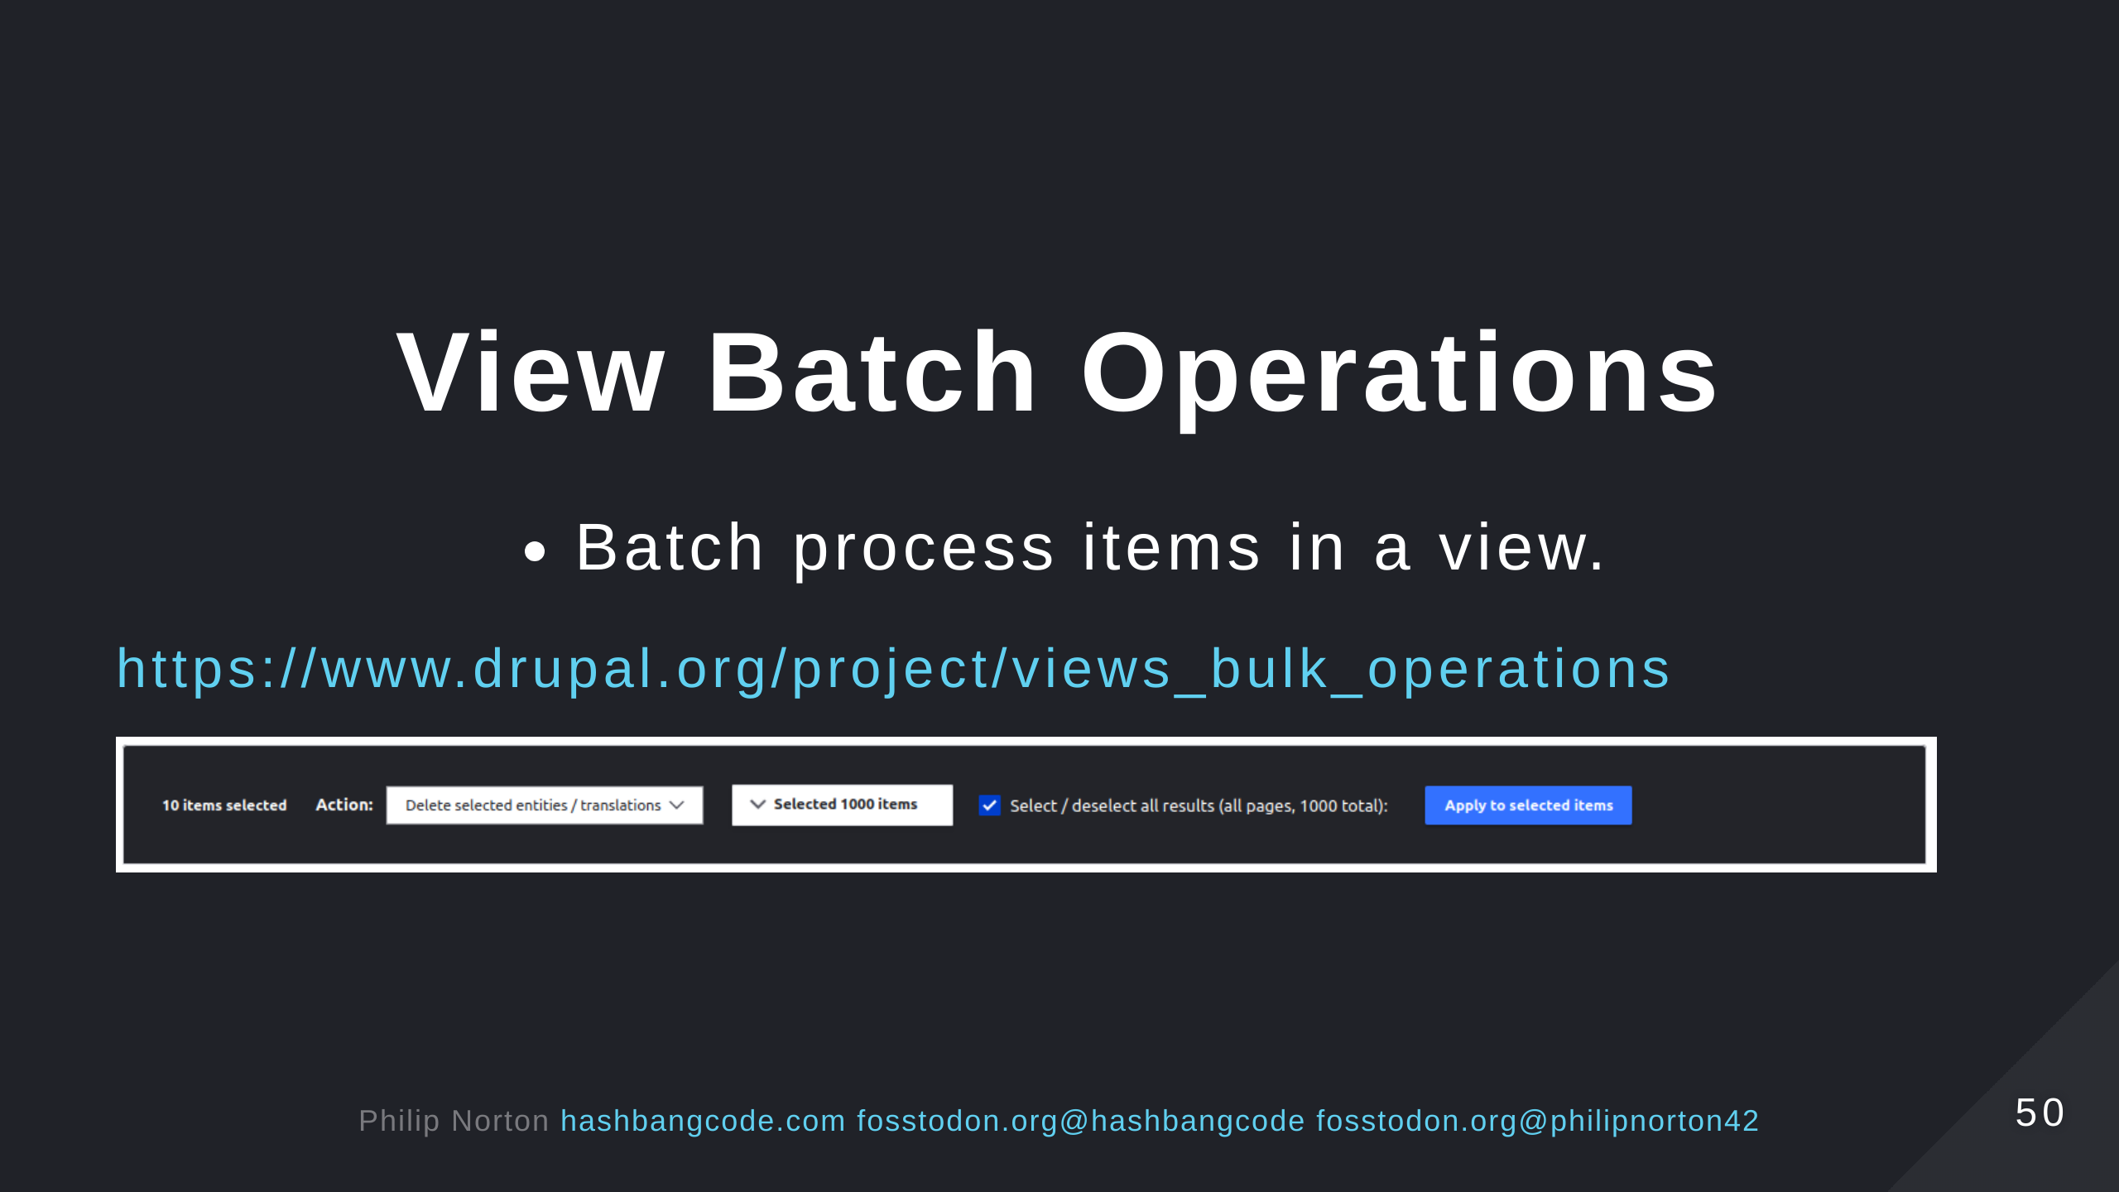

Slide 51


Slide 52


Slide 53

Notes:
- See the list at the repo page https://github.com/hashbangcode/drupal-batch-api-talk.

Slide 54


Slide 55


